Slide 1
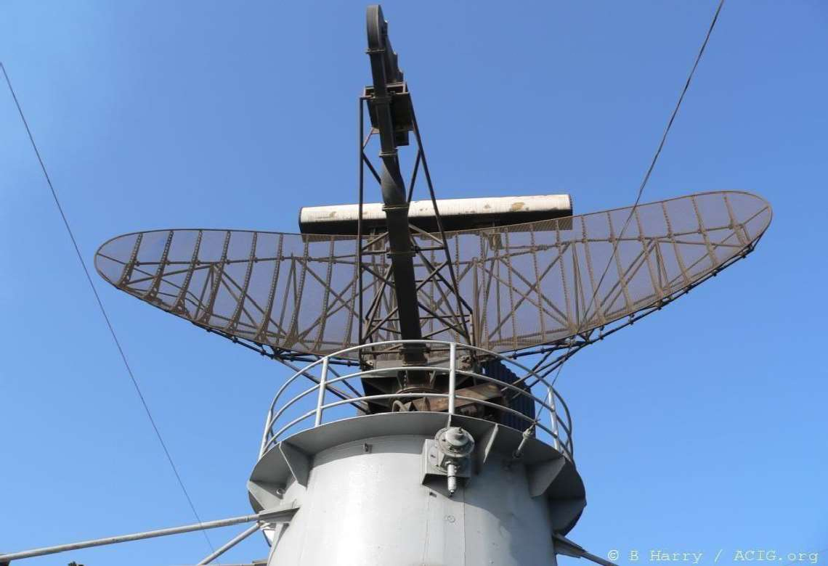
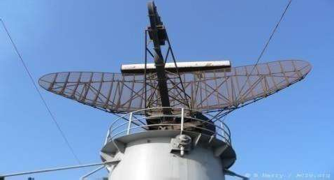
PPT
ON
RADAR SYSTEMS
IV B.Tech I semester
Mr.G.S.J.Victor
Assistant Professor
Unit I
BASICS OF RADAR
ELECTRONICS AND COMMUNICATION ENGINEERING
(NARASARAOPETA ENGINEERING COLLEGE Autonomous)
1
2
CONTENTS :: UNIT-I
Radar History Nature Of Radar
Maximum Unambiguous Range Radar Wave Forms
Radar Range Equation Radar Block Diagram Radar Frequencies Radar Applications Related Problems
Radar History
Radio Detection And Ranging
Hertz
Christian Hulsmeyer
Albert H.Taylor and Leo C.Young
Monostatic,Bistatic and Multistatic Radars
3
4

Slide 2
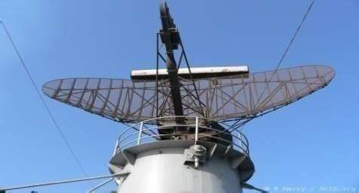
Nature of radar
Radar operates by radiating energy Duplexer
Echo signal Doppler effect
Maximum Unambiguous Range
Echoes that arrive after the transmission of the next pulse are called second-time- around(or multiple-time-around) echoes.
The range beyond which targets appear as second-time-around echoes is called the
1 Nautical mile=1.852 km
Maximum
unambigu
ous range
5
6
Radar Range Equation
If the power of the radar transmitter is denoted by Pt , and if an isotropic antenna is used (one which radiates uniformly in all directions), the power density(watts per unit area) at a distance R from the radar is equal to the
transmitter power divided by the surface area of an imaginary sphere
of radius R,
Radar Wave Forms
Transmitted Power::
1 Mega watt
Pulse Width ::
1 Micro second
Pulse Repetition Period :: 1 Milli second
Average Power can be calculated as
The power density at the target from an antenn a with a transmitting gain G is
Transmitted Power * Pulse Width *Pulse Repetition Frequency
The measure of the amount of incident power intercepted by the target and reradiated back in the direction of the radar is denoted as the radar cross
defined by the relation
Energy :: Transmitted Power * Pulse Width
7
8

Slide 3
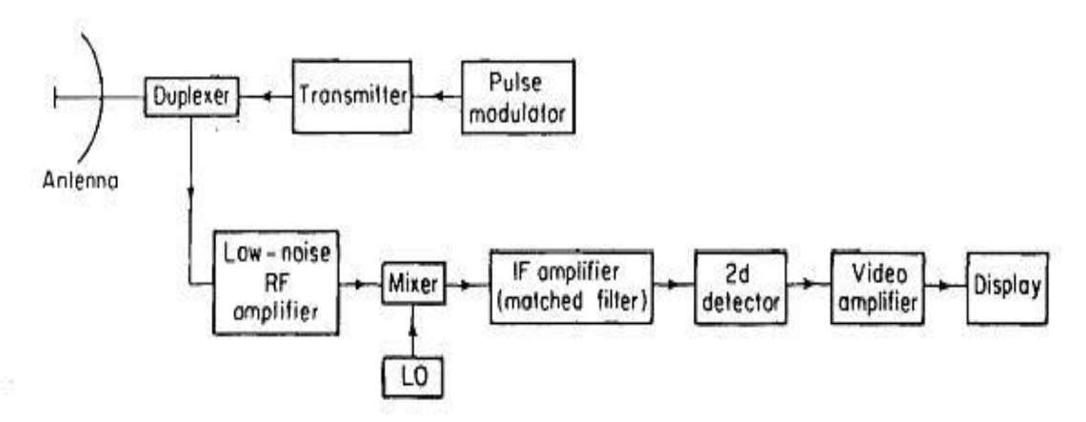
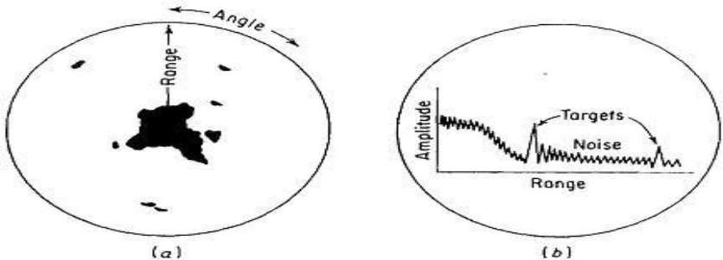
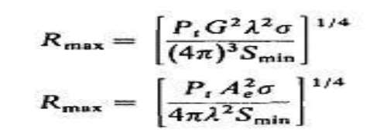
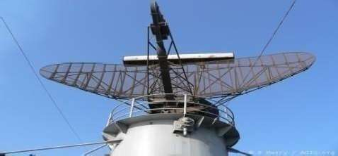
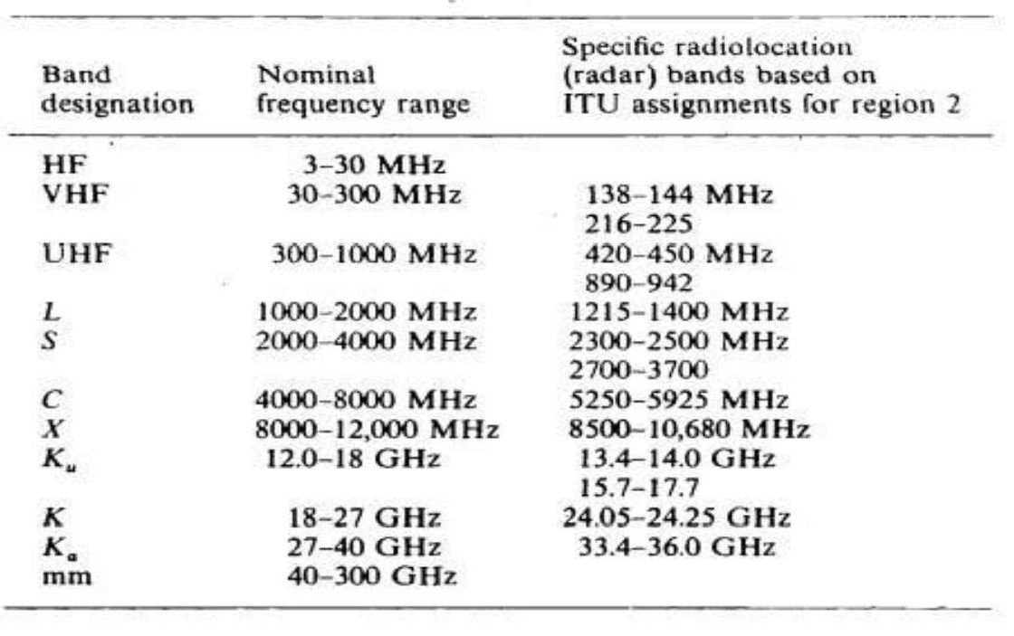
Radar Range Equation
Radar Block Diagram
If the effective area of the receiving antenna is denoted Ae, the power Pr, received by the radar is
The maximum radar range Rmax is the distance beyond which the target cannot be detected. It occurs when the received echo signal power P, just equals the minimum detectable signal Smin,
Antenna theory gives the relationship between the tran smitting gain and the receiving effective area of an antenna as
Two other forms of the rada
equar tion
9
10
Radar Frequencies
Radar Applications
Air Traffic Control (ATC)
Aircraft Navigation Ship Safety Remote Sensing Space
Law Enforcement Military
11
12

Slide 4
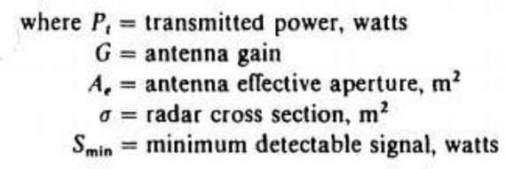
RADAR EQUATIONS
Prediction of Range Performance Minimum Detectable Signal Receiver Noise and SNR Integration of Radar pulses Radar Cross Section of targets Transmitted Power
Pulse Repetition Frequencies System Losses
Prediction of Range Performance
The simple form of the radar equation expressed the maximum radar range Rmax, in terms of radar and target parameters
All the parameters are to some extent under the control of the radar designer, except for the target cross section
13
14
Minimum Detectable Signal
Minimum Detectable Signal
The weakest signal the receiver can detect is called the minimum detectable signal.
A matched filter for a radar transmitting a rectangular- shaped pulse is usually characterized by a bandwidth B approximately the reciprocal of the pulse width
1
Detection is based on establishing a threshold level at the output of the receiver.
If the receiver output exceeds the threshold, a signal is assumed to be present. This is called threshold detection.
Probability of Miss. Probability of False Alarm.
or
15
16

Slide 5
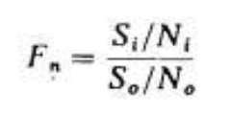
Receiver Noise and SNR
Receiver Noise and SNR
Since noise is the chief factor limiting receiver sensitivity, it is necessary to obtain some means of describing it quantitatively
Noise is unwanted electromagnetic energy which interferes with the ability of the receiver to detect the wanted signal.
The available thermal-noise power generated by a receiver of bandwidth Bn, (in hertz) at a temperature T (degrees Kelvin) is
17
where k = Boltzmann's constant = 1.38 x 10-23 J/deg. Bandwidth and is given by
If the minimum detectable signal Smin, is that value of Si corresponding to the minimum ratio of output (IF) signal-to-noise ratio (So /No)min necessary for detection.
18
Receiver Noise and SNR
The noise entering the IF filter (the terms filter and amplifier are used interchan ability-density
function g
The probability that the envelope of the noise voltage will lie b
The probability that the noise voltage envelope will exceed the voltage th
geably) is assumed to be guassian, with prob
iven by
etween the values of V1 and V2 is
reshold VTis
19
20

Slide 6
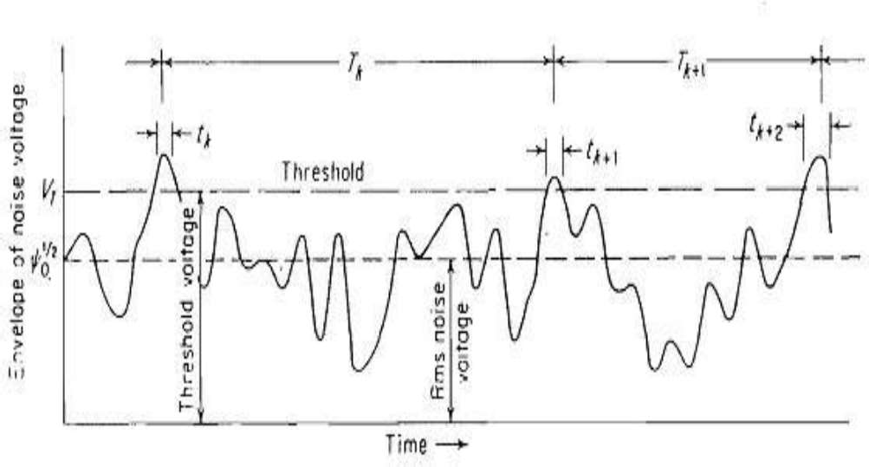
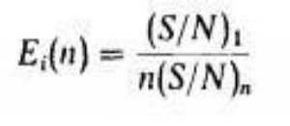
Consider sine-wave signals of amplitude A to be present along with noise at the input to the IFfilter. The frequency of the signal is the same as the IF midband frequency fIF. The output or theenvelope detector has a probability-densi
ty function givenby
The average time interval between crossings of the threshold by noise alone is de arm time Tfa,
fined as the false-al
where Io (Z) is the modified Bessel function of zero order and argument Z
21
22
Integration of Radar pulse
s
Radar Cross Section
23
24

Slide 7
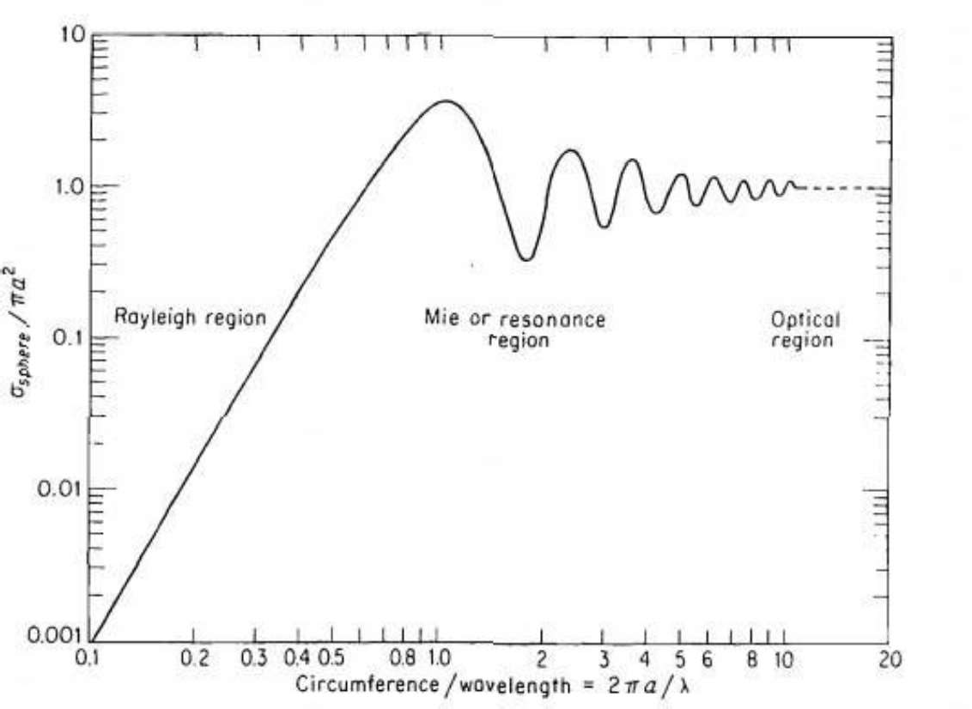
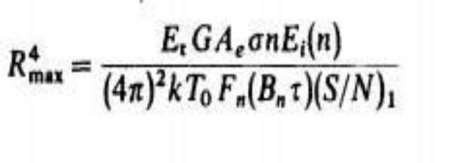
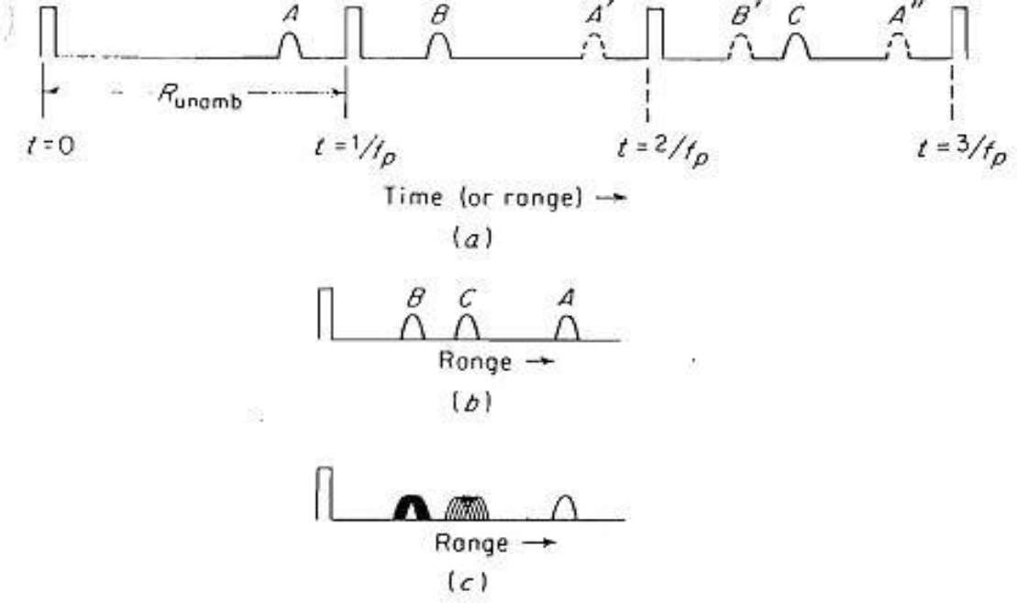
Transmitted Power
25
26
Pulse Repetition Frequen
cies
Collapsing loss
Operator loss
Field Degradation Propogation Effects
27
28

Slide 8
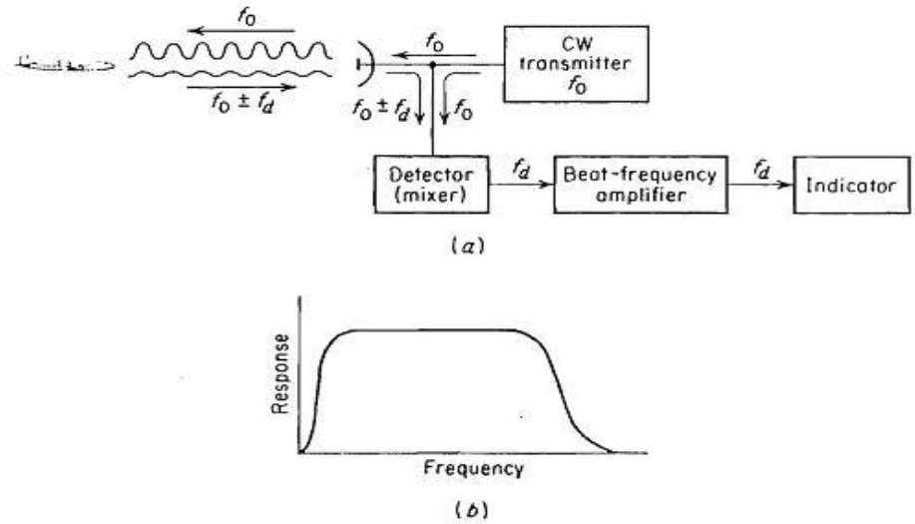
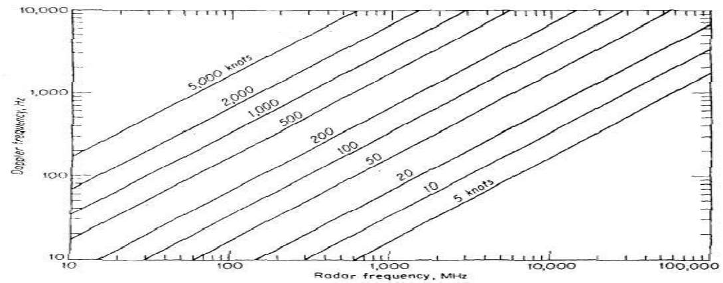
CONTENTS :: UNIT-II
Doppler Effect
Separate antennas for transmission and
reception help segregate the weak echo from the strong leakage signal
Doppler angular frequency by
Doppler Effect
CW Radar Block Diagram
Isolation Between Transmitter and Receiver Non Zero IF Receiver
Receiver Bandwidth Requirements
Identification of Doppler Direction in CW Radar
Applications of CW Radar
CW Radar Tracking Illuminator
Where,
fd = Doppler frequency shift
vr = relative (or radial) velocity of target with to radar.
The Doppler frequency shift is fd fo / c where,
fo = transmitted frequency
c = velocity of propagation = 3 x 108m/s. If fd is in hertz vr in knots, and in meters, fd = 1.03 * vr /
29
30
Doppler Effect
CW Radar Block Diagram
The relative velocity may be written vr = v cos v is the target speed and the
Angle made by the target trajectory and the line joining radar and target.
The Doppler frequency is maximum.
The Doppler is zero when the trajectory is perpendicular to theradar line of sight = 90 ).
31
32

Slide 9
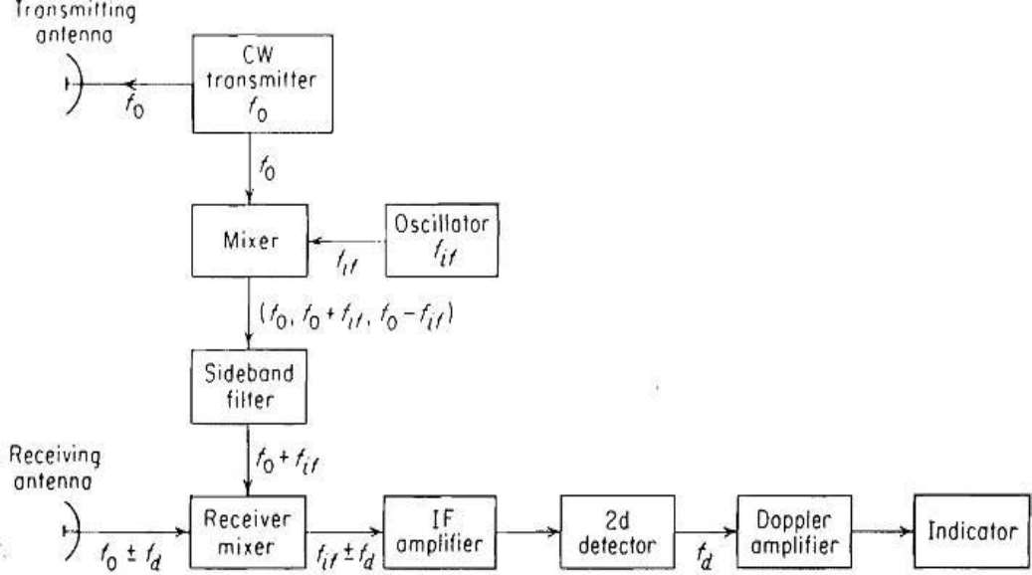
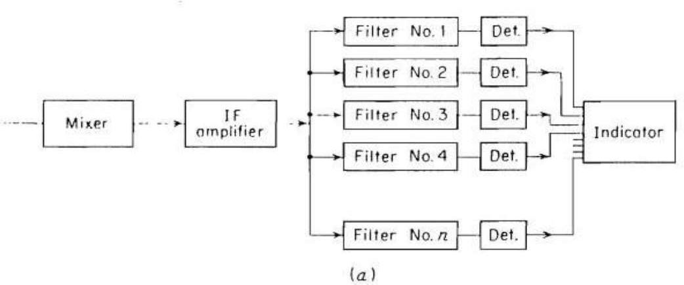
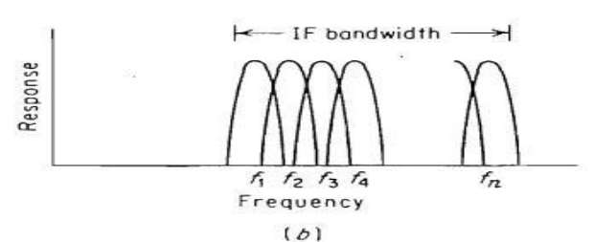
Isolation Between Transmitter and Receiver
Isolation betweenthe transmitted and the
received signals is achieved via separation in frequency as a result of the doppler effect.
There are two practical effects which limit the amount of transmitter leakage power which can be tolerated at the receiver.
The maximum amount of power the receiver input circuitry can withstand before it is physically damaged or its sensitivity reduced
The amount of transmitter noise due to hum, microphonics etc.
Isolation Between Transmitter and
Receiver
The amount of isolation which can be readily achieved between the arms of practical hybrid junctions such as the magic-T is of the order of 20 to 30 dB.
Separate polarizations
VSWR
Separate antennas
Dynamic cancellation of leakage
33
34
Non Zero IF Receiver
Receiver Bandwidth Requirements
35
36

Slide 10
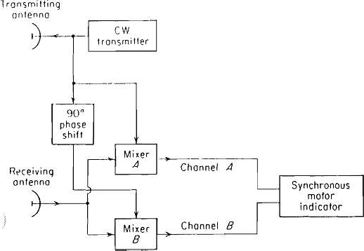
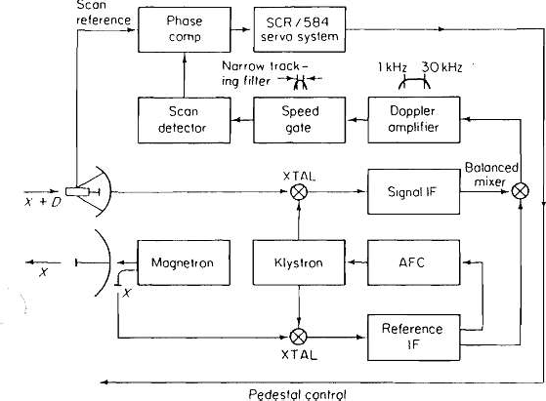
Identification of Doppler Direction in
Identification of Doppler Direction in CW Radar
CW Radar
The outputs from the two channels are
EA ( + ) = K2 E0 cos (
)
EB ( + )= K2 E0 cos (wd )
If the targets are receding (negative doppler), the outputs from the two channels are
EA ( - ) = K2 E0 cos (wd t - )
EB ( - )= K2 E0 cos (wd t - - )
The direction of motor rotation is an indication of the direction of the target motion.
37
38
Applications of CW Radar
CW Radar Tracking Illuminator
Police speed monitor Collision avoidance. Control of traffic lights
CW radar can be used as a speedometer to replace the conventional tachometer in Railways
Warning of approaching trains. Speed of large ships.
Velocity of missiles
39
40

Slide 11
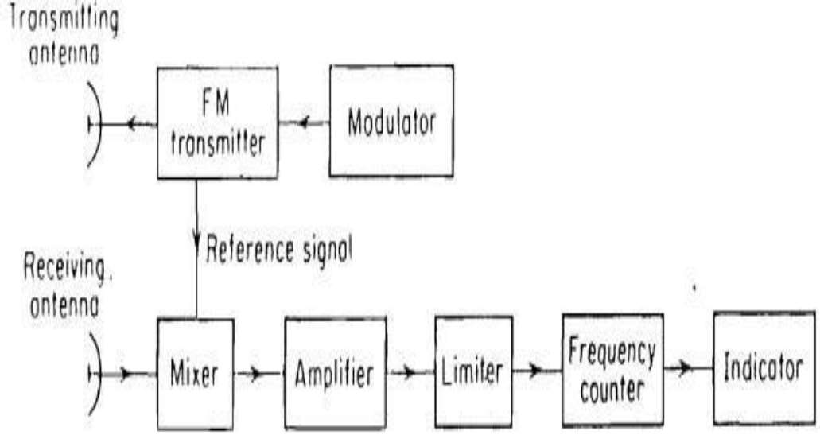
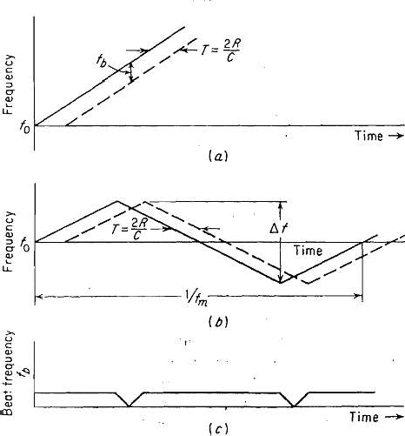
FM-CW RADAR
FMCW Radar
FMCW Radar
Range and Doppler Measurement Approaching and Receding Targets
FMCW Altimeter Measurement Errors Unwanted Signals Sinusoidal Modulation
Multiple Frequency CW Radar
41
42
Range and Doppler Measurement
Range and Doppler Measurement
If the rate of change of the carrier frequency is f0, the beat frequency is
fr = f0 T = 2 R f0 / c
If the frequency is modulated at a rate fm over a range the beat frequency is
fr = 2 * 2 R fm / c = 4 R / c
Measurement of the beat frequency determines the range R.
R = c fr / 4 fm
(a) Linear frequency modulation (b) triangular frequency modulation; (c) beat note of (b).
43
44

Slide 12
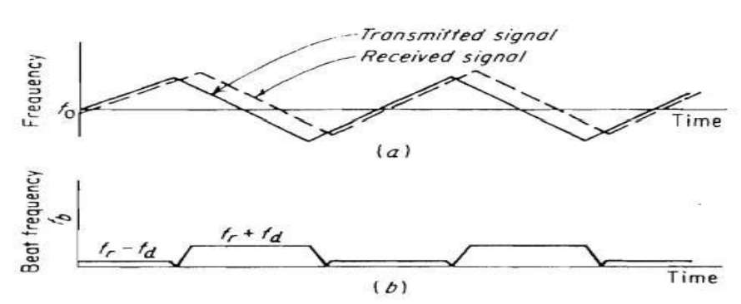
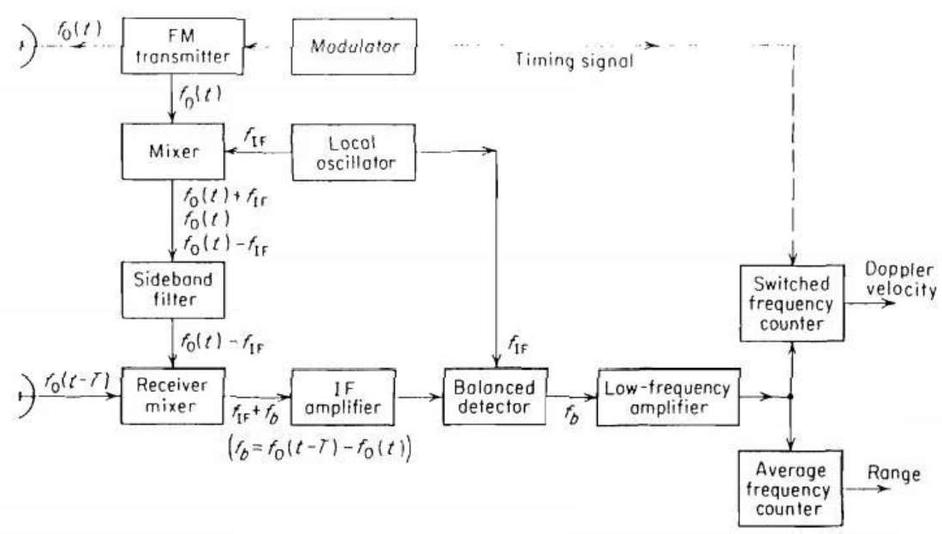
Range and Doppler Measurement
Approaching and Receding Targets
FM cycle will be the difference between the beat frequency due to the range fr, and the doppler frequency shift fd
fb(up) = fr - fd fb(down) = fr + fd
The range frequency fr, may be extracted by measuring the average beat frequency that is,
fr = 1/2[fb(up) + fb(down)]. fd = 1/2[fb(up)-fb(down)].
Transmitted (solid curve) and echo (dashedcurve)
beat frequency
fr > fd fr < fd
Target Approaching Target Receding
45
46
FMCW Altimeter
Measurement Errors
The average number of cycles N of the beat frequency fb in one period of the modulation cycle fm is fb /fm , where the bar over , denotes time average.
Which measures the number of cycles or half cycles of the beat during the modulation period.
The total cycle count is a discrete- number since the counter is unable to measure fractions of a cycle.
The discreteness of the frequency measurement gives rise to an error called the fixed error, or step erroror quantization error
47
48

Slide 13
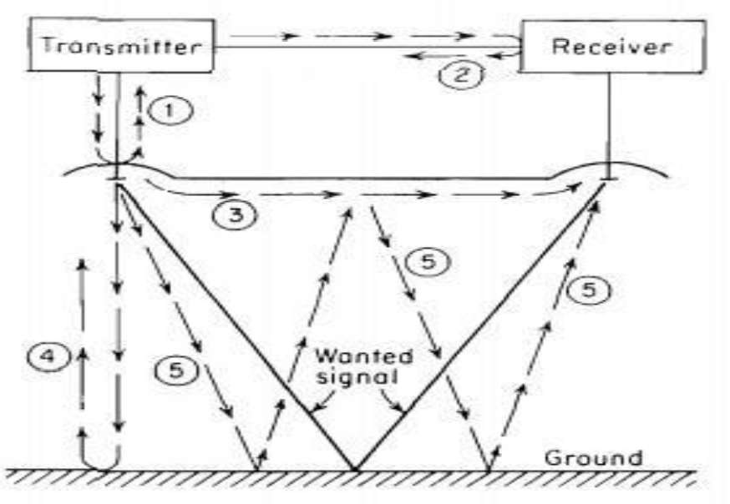
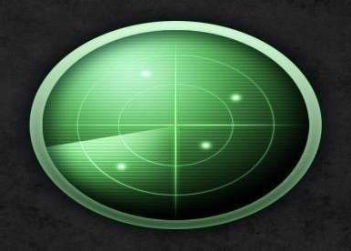
Measurement Errors
Unwanted Signals
f
Where, R = range (altitude). m c = velocity of propagation. m/s
excursion. Hz
= frequency
Since the output of the frequency counter N is an integer, the range will be an integral multiple of
f and will give rise to a quantization error equal to
f
(m) f ( MHz)
49
50
Unwanted Signals
Sinusoidal Modulation
The Unwanted signals include 1.Transmitting Antenna impedance mismatch 2.Receiver poor mixer match.
Coupling between transmitter and receiver antennas
The interference due to power being reflected back to the transmitter
If the CW carrier is frequency-modulated by a sine wave, the difference frequency obtained by heterodyning the returned signal with a portion of the transmitter signal may be expanded in a trigonometric series whose terms are the harmonics of the modulating frequency
Assume the. formwohfereth, e transmitted signal
5. The double-bounce signal.
fm
tboe
fo = carrier frequency
fm = modulationfrequency f = frequency excursion
51
52

Slide 14
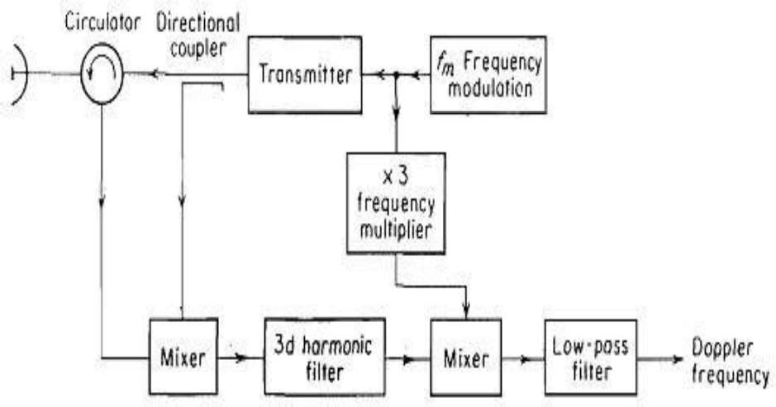
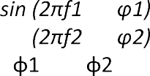
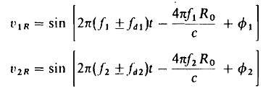
Sinusoidal Modulation
Sinusoidal Modulation (3rd Harmonic) Extraction
The difference frequency signal may be
written as
where J0, J1, J2, etc = Bessel functions of first kind and order 0, 1, 2, etc., respectively
D = f / fm ) sin fm R0 /c
R0 = distance to target at time t = 0 (distance that would have been measured if target
were stationary)
c = velocity of propagation
fd = doppler frequency shift
vr = relative velocity of target with respect to radar
= phase shift approxirnately equal to angular distance f0 R0 /c
= phase shift approxirnately equal to fm R0 /c
53
54
Multiple Frequency CW Radar
Multiple Frequency CW Ra
da
r
Where, Ro = range to target at a particular time t = t0 (range that would be measured if target were not moving)
fd1 = doppler frequency shift associated with frequency f1
fd2 = doppler frequency shift associated with frequency
The voltage waveforms of the two components of the transmitted signal v1r and v2r, may be written as
v1r = v2r = sin where
angles.
t +
t +
and are arbitrary (constant) phase
f2
Since the two RF frequencies f1 , and f2 are approximately the same the doppler frequency shifts fd1 and fd2 are approximately equal to one another.
Therefore
fd1 = fd2 = fd
The echo signal is shifted in frequency by the
dopp s
ignleremayffect. The form of the dopplershifted
ls at each of the two frequencies f1 and f2 be written as
a
55
56

Slide 15
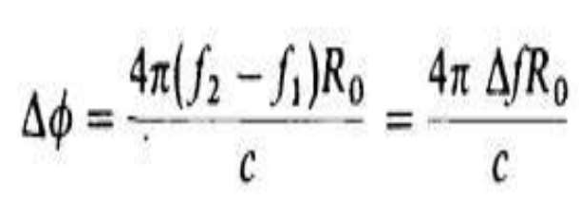
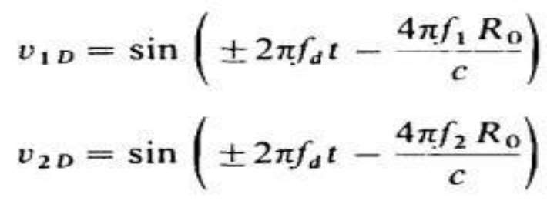
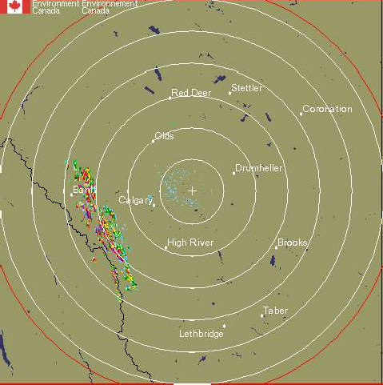
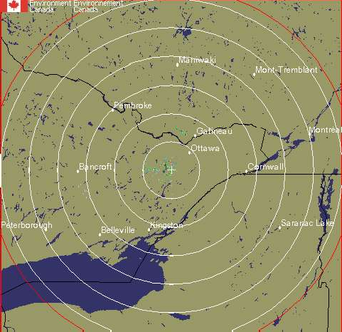
Multiple Frequency CW Rada
r
The receiver separates the two components of
the echo signal and heterodynes each received signal component with the corresponding transmitted waveform and extra
com
Multiple Frequency CW Radar
The phase difference between these two components is
cts the two doppler-frequency
ponents given below:
57
58
Multiple Frequency CW
UNIT III
There is a limit to the value of since cannot be greater than radians if the range is to remain unambiguous
Moving Target Indicator Radar (MTI)
Clutter is the term used for radar targets which are not of interest to the user.
Clutter is usually caused by static objects near the radar but sometimes far away as well:
Runamb = c /
must be less than c/2 Runamb
When is replaced with Pulse Repetition Rate gives
Maximum Unambiguous Range of a Pulse Radar.
n
n
59
60

Slide 16
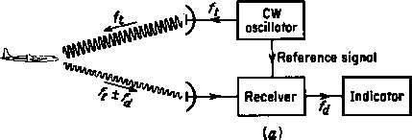
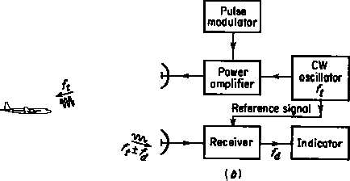
Moving Target Indicator Radar (MTI)
Sometimes clutter can be caused by sidelobes in the antenna pattern or a poorly adjusted antenna
Moving Target Indicator Radar (MTI)
This is done by using the fact that the desired target is usually moving relative to the radar and thus causes a Doppler shift in the return signal.
The Doppler shift can also be used to determine the relative speed of the target.
n
n
n n
In any case it is desirable to eliminate as mucnh clutter as possible
n
n
n
61
62
Moving Target Indicator Radar (MTI)
The simple CW example can be modified to incorporate pulse modulation
Moving Target Indicator Radar (MTI)
The transmitted signal is
and the received signal is
n
n
these are mixed and the difference is extracted
n
n
n
n
This has two components, one is a sine wave at
Doppler frequency, the other is a phase shift which
depends on the range to the tar^{n}get, R₀
n
Note that the same oscillator is used transmission and demodulation of the return
Thus the return is processed coherently
i.e. the phase of the signal is preserved
63
64

Slide 17
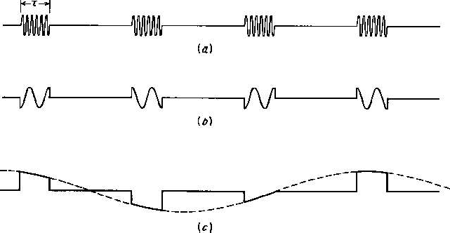
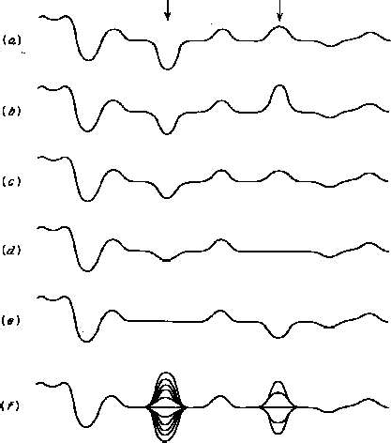
Moving Target Indicator Radar (MTI)
Moving Target Indicator Radar (MTI)
Note that for a the dividing line is a Doppler shift of 1 MHz.
Note that for stationary targets f_{d} = 0 so V_{diff} is constant
If the carrier frequency is 1 GHz, this implies a relative speed of 30,000 m/s
Thus all terrestrial radars operate in a sampled mode and thus are
Depending on the Doppler frequency one two situations will occur
n
n
subject to the rules of sampled signals
n n
e.g. criterion
We shall also see that we can use Discrete Sample Processing (DSP) to
f_{d}
n
n
handle some of the problems
n
n
f_{d}
65
66
Moving Target Indicator Radar (MTI)
Moving Target Indicator Radar (MTI)
Looking a successive oscilloscope displays of radar receiver output we see:
We usually want to process the information automatically. To do this we take advantage of the fact that the amplitudes of successive pulse returns are different:
At the ranges of the two targets, the return ampliude is varying as the radar samples the (relatively) slow Doppler signal.
The bottom trace shows what would be seen in real time with the moving targets indicated by the amplitude changes
n
n
n
n
n
n
OR
n
n
-
_{z}-1
67
68

Slide 18
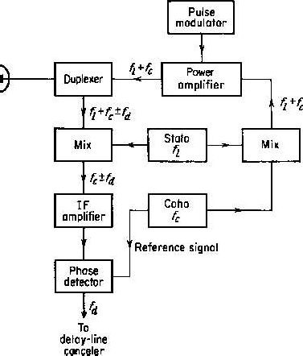
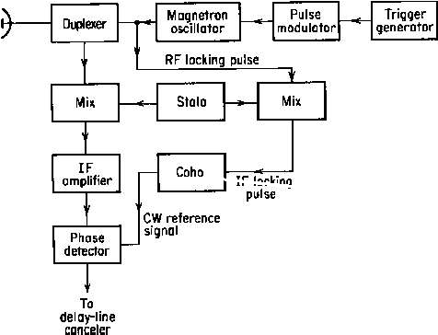
Moving Target Indicator Radar (MTI)
MTI Radar Block Diagrams
MOPA (master oscillator, power amplifier)
Moving Target Indicator Radar (MTI)
One of the problems with MTI in pulsed radars is that magnetrons are ON/OFF devices.
Power amplifiers: Klystron
TWT (Travelling wave tube) Solid State (Parallel)
i.e. When the magnetron is pulsed it starts up with a random phase and is thus its ouput is not coherent with the pulse before it. Also it can not provide a reference
n
n
n
oscillator to mix with the received signals.
n n
Therefore some means must be provided to maintain the coherence (at least
during a single pulse period)
n
n
n
69
70
Moving Target Indicator Radar (MTI)
Moving Target Indicator Radar (MTI)
The notes have a section on various types of delay line cancellers.
This is a bit out of date because almost all radars today
use digitized data and implementing the required delays is relatively trivial but it also opens up much more complex processing possibilities
n n
n n
n
PLL
n
n
n
71
72

Slide 19
Moving Target Indicator Radar (MTI)
Moving Target Indicator Radar (MTI)
The Filtering Characteristics of a Delay Line Canceller
If the first blind speed is to be greater than the highest expected radial speed the
_{p} must be large
The output of a single delay canceller is:
large larger antennas for a given beamwidth
large f_{p} means that the unambiguous range will be quitensmall
n
n
n
This will be zero whenever _{d}T is 0 or a multiple of The speeds at which this occurs are called the blind^{n}
So there has to be a compromise in the design of an MTI radar
speeds of the radar
.
n
n
where n is
n
73
74
Moving Target Indicator Radar (MTI)
Moving Target Indicator Radar (MTI)
The choice of operating with blind speeds or ambiguous ranges depends on the application
Double Cancellation:
Single cancellers do not have a very sharp cutoff at the nulls which limits their rejection of clutter
Two ways to mitigate the problem at the expense of increased complexity are:
(clutter does not have a zero width spectrum)
operating with multiple prfs
operating with multiple carrier frequencies
n n
Adding more cancellers sharpens the nulls
n n
n
n
n
n
75
76

Slide 20
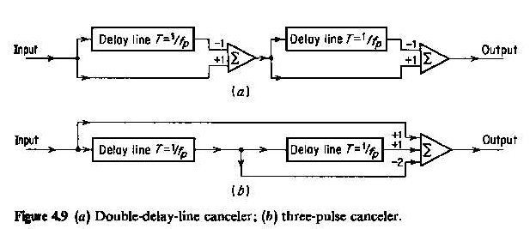
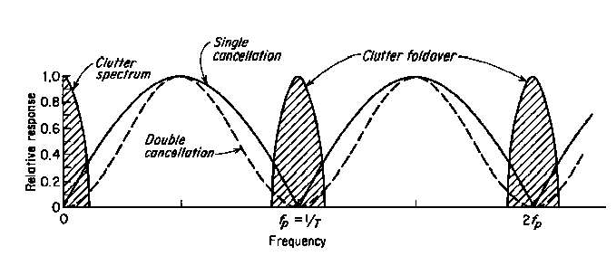
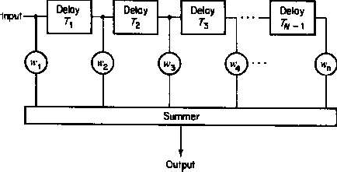
Moving Target Indicator Radar (MTI)
Double Cancellation:
Moving Target Indicator Radar (MTI)
Double Cancellation:
There are two implementations:
n
n
n
n
n
n
n
n
These have the same frequency response: which is the square of the single canceller response
v 4sin² ( f_{d}T )
77
78
Moving Target Indicator Radar (MTI)
Moving Target Indicator Radar (MTI)
Transversal Filters
Transversal Filters
To obtain a frequency response of sin^{n} _{d}T, the taps must be binomially weighted i.e.
These are basically a tapped delay line with the taps summed at the output
n
n
n n
n
n
n
n
79
80

Slide 21
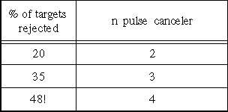
Moving Target Indicator Radar (MTI)
Filter Performance Measures
Moving Target Indicator Radar (MTI)
Filter Performance Measures
MTI Improvement Factor, I_{C}
I
C
(S / C)_{out}
Clutter Attenuation ,C/A
(S /C)
in
The ratio of the clutter power at the input of the canceler
Note that this is averaged over all Doppler frequencies
n
to the clutter power at the output of the cancelern
n
It is normalized, (or adjusted) to the signal attenuation of the canceler.
Signal
Clutter
n
Filter
n
n
i.e. the inherent signal attenuation of the cancelernis ignored
n
0
1/2T
0
1/2T
81
82
Moving Target Indicator Radar (MTI)
Moving Target Indicator Radar (MTI)
Transversal Filters with Binomial Weighting with alternating sign
Transversal Filters with Binomial Weighting with alternating sign
Advantages:
Disadvantage:
Close to optimum for maximizing the Clutter improvement factor
As n increases the sin^{n} filter cuts off more and more of the spectrum around DC and multiples of PRF
n
This leads to wider blind speed zones and hence loss_{n}of legitimate targets.
n
Also close to maximizing the Clutter Attenuation _{n}
Cin/Cout
(S /C)
I_{C}
out
(S / C)_{in}
n
n
n
n
83
84

Slide 22
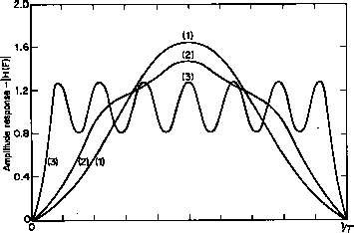
Moving Target Indicator Radar (MTI)
The ideal MTI filter should reject clutter at DC and th PRFs but give a flat pass band at all other frequencies.
Moving Target Indicator Radar (MTI)
Some other transversal filter responses are shown:
The ability to shape the frequency response depends to a large degree on the number of pulses used. The more pulses, the more flexibility in the filter design.
Unfortunately the number of pulses is limited by the scnan rate and the
banetaemnnwaidth.
n
n
n
n
Note that not all pulses are useful:
n
The first n-1 pulses in an n pulse canceler are not useful
n
n
3 pulse canceler
5 pulse filter which maximizes I_{C}
15 pulse Chebyshev filter
85
86
Moving Target Indicator Radar (MTI)
Feed forward (finite impulse response or FIR) filters have only poles (one per delay)
Moving Target Indicator Radar (MTI)
IIR filters can be designed using standard continuous-time filter techniques and then transformed into the discrete form using z transforms
Thus almost any kind of frequency response can be obtained with these filters.
More flexibility in filter design can be obtained if we use recursive or feedback filters (also known as infinite impulse response or IIR filters)
These have a zero as well as a pole per delay and thus have twice as many variables to play with
They work very well in the steady state case but unfortunately their transient response is not very good. A large pulse input can cause the filter to and thus miss desired targets.
Since most radars use short pulses, the filters are almost always in a transient state
87
88

Slide 23
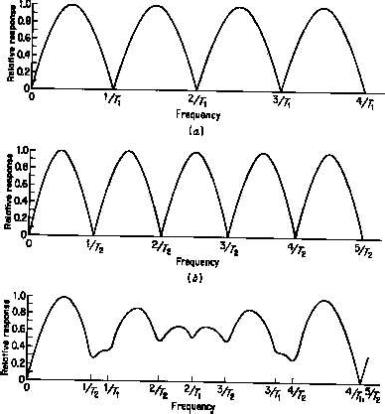
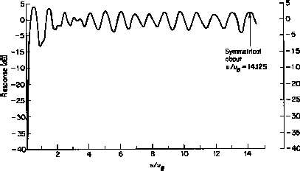
Moving Target Indicator Radar (MTI)
Multiple PRFs
An alternative is to use multiple PRFs because the blind speeds (and hence the shape of the filter response) depends on the PRF and, combining two or more PRFs offers an opportunity to shape the overall response.
Moving Target Indicator Radar (MTI)
Multiple PRFs: Example
Two PRFs Ratio 4/5
First blind speed is at 5/T₁ or 4/T₂
89
90
Moving Target Indicator Radar (MTI)
Multiple PRFs: Example
Moving Target Indicator Radar (MTI)
Multiple PRFs: Example
Four PRFs
Ratio 25/30/27/31
Calculation of First Blind Speed
if the relationship between the Pulse Periods is
First blind speed is at about 28.25/T_{AV}
n₁ n₂
T₁ T₂
n_{N}
T_{N}
where T_{AV}
is the average period of the four PRFs
and v_{B} is the first blind speed of a PRF with average period
^{T}AVE
1 _{T1 T2}
T_{N}
N
The first blind speed is
v v
n₁ n₂ n_{N}
1
B
N
91
92

Slide 24
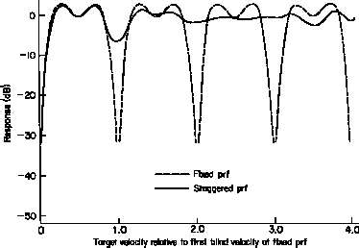
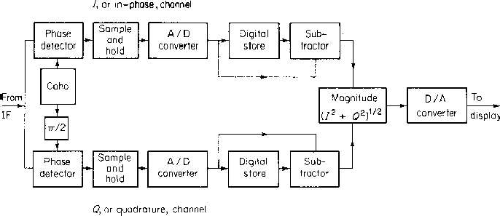
Moving Target Indicator Radar (MTI)
Multiple PRFs can also be used with transversal filters
Moving Target Indicator Radar (MTI)
Digital (or Discrete) Signal Processing (DSP)
Example
5 pulse canceler with 4 staggered PRFs
These days almost all radar signal processing is done using DSP.
The down-converted signal is sampled by an A/D converter as follows:
n
n
n n
Note:
The quadrature channel removes blind phases
93
94
Moving Target Indicator Radar (MTI)
Advantages of DSP greater stability greater repeatability greater precision greater reliability
easy to implement multiple PRFs greater flexibility in designing filters
gives the ability to change the system parameters dynamically
Moving Target Indicator Radar (MTI)
Digital (or Discrete) Signal Processing (DSP)
Note that the requirements for the A/D are not very difficult to meet with technology.
Sampling Rate
Assuming a resolution (R_{res}) of 150m, the received signal has to be sampled at intervals of c/2R_{res} = a sampling rate of 1 MHz
Memory Requirement
Assuming an antenna rotation period of 12 s (5rpm) the storage required would be only 12 Mbytes/scan.
95
96

Slide 25
Moving Target Indicator Radar (MTI)
Digital (or Discrete) Signal Processing (DSP)
Moving Target Indicator Radar (MTI)
Digital (or Discrete) Signal Processing (DSP)
Quantization Noise
The A/D introduces noise because it quantizes the signal
Dynamic Range
This is the maximum signal to noise ratio that can be handled by the A/D without saturation
The Improvement Factor can be limited by the quantization noise the limit being:
dynamic _ range
N= number of bits
₂2N 3 _{/ k} 2
I 20log (2^{N} 1) 0.75
k=rms noise level divided by the quantization interval the larger k the lower the dynamic range
but k<1 results in reduction of sensitivity
QN
This is approximately 6 dB per bit
A 10 bit A/D thus gives a limit of 60 dB
In practice one or more extra bits to achieve the desired performance
Note: A 10 bit A/D gives a dynamic range of 45.2dB
97
98
Moving Target Indicator Radar (MTI)
Blind Phases
If the prf is double the Doppler frequency then every othyer pair of samples cane be the same amplitude and will thus be filtered out of the signal.
Moving Target Indicator Radar (MTI)
Blind Phases
If the prf is double the Doppler frequency then every other pair of samples can be the same amplitude and will thus be filtered out of the signal. (loss of 2.8dB and 13.7dB for P_{d} of 0.5 and 0.9 respectively)
By using both inphase and quadrature signals, blind phases can be eliminated
By using both inphase and quadrature signals, blind phases can be eliminated
99
100

Slide 26
Moving Target Indicator Radar (MTI)
Digital Filter Banks and FFT
Example: Transversal Filter with 8 delay elements:
Moving Target Indicator Radar (MTI)
The impulse response of this filter is:
h_{k} (t)
N
i 1
t (i 1)T e
j 2 (i 1)k / N
_{z}-1
_{z}-1
_{z}-1
_{z}-1
_{z}-1
_{z}-1
_{z}-1
_{z}-1
And from the Fourier transform its frequency response is
w
w
w
w
w
w w
w
H ( f ) e
j2 fT
N
_{e} j2 (i 1) fT k / N
SUMMER
k
i 1
If the weights are set to:
The magnitude of the response is
wik
e
j 2 (i 1)k / N
H _{k} ( f )
k / N
sin N ( fT k / N
and k is an index from 0 to N-1
sin ( fT
101
102
Moving Target Indicator Radar (MTI)
Moving Target Indicator Radar (MTI)
The response for all eight filters is:
H _{k} ( f )
k / N
sin N ( fT k / N
sin ( fT
k=0
k=1
0
1/T
0
1/T
103
104

Slide 27
Moving Target Indicator Radar (MTI)
The actual response for this filters is:
Moving Target Indicator Radar (MTI)
Other options are:
Uniform weighting and Chebyshev weights
Which is sin (Nx)/sin(x)
The sidelobes of this filter are quite large (13dB below peak) and so it is not an ideal implementation
Clutter Improvement with Uniform weighting (Filter Bank Only)
105
106
Moving Target Indicator Radar (MTI)
Moving Target Indicator Radar (MTI)
Filter Banks can also be preceded by cancelers
Filter Banks can also be preceded by cancelers
In the following cases a 3 pulse canceler is used ahead of an 8 pulse Doppler Filter Bank
In the following cases a 3 pulse canceler
Uniform
Chebyschev
107
108

Slide 28
Moving Target Indicator Radar (MTI) MTD (Moving Target Detector)
Moving Target Indicator Radar (MTI) MTD (Moving Target
Example: ASR (Airport`Surveillance Radar)
After the filter bank the doppler filter outputs are weighted to reduce the effects of the sidelobes in the filter
Example: ASR (Airport`Surveillance Radar
Detector)
)
The outputs of the filters are modified by subtracting 25% of the outputs of the filters on either side.
109
111100
Moving Target Indicator Radar (MTI) MTD (Moving Target Detector)
Moving Target Indicator Radar (MTI) Limitations of MTI Performance
Definitions:
Example: ASR (Airport`Surveillance Radar)
MTI Improvement Factor (I _{C})
(S /C)
out
Defined earlier Subclutter Visibility(SCV)
I
C
(S /C) _{in}
The ratio by which a signal may be weaker than
the coincident clutter and stll be d_{SCV}
etected with
velocities
(C / S)_{IN}
the specified P_{d} and P_{fa}. All radial
Clu_{a}t_{s}t_{s}e_{u}r_{m}Vi_{e}s_{d}ib_{e}il_{q}it_{u}y_{a}F_{l}a_{ly}ct_{li}o_{k}r_{el}(_{y}V_{.OC})
The Signal to Clutter ratio
after filtering that provides the _{VOC}
(S /C)_{OUT}
specified P_{d} and P_{fa}.
111
112

Slide 29
Moving Target Indicator Radar (MTI) Limitations of MTI Performance
Definitions:
Moving Target Indicator Radar (MTI) Limitations of MTI
Equipment Instabilities: Performance
Changes in signal from pulse to pulse will result in apparent clutter Doppler shift
These changes can have many sources
n
pulse to pulse change in
Clutter Attenuation Defined earlier
Cancellation Ratio
CA (C_{IN} / C_{OUT} )
n n
The ratio by which a signal may be weaker than the coincident clutter and stll be^{n} detected with
^{a m}pu^{p}l^{n}s^{l}e^{itu}to^{de}pulsechange in frequency
the specified P_{d} and P_{fa}. All radia^{n}l velocities
n
pulse to pulse change in phasen
timing jitter
Changes in pulse width
Changes in oscillator frequency between Tx and Rx
No_{a}t_{s}e_{su}
C S
S C
med equally likely.
I_{C}
(SCV )(V_{OC} )
IN
OUT
113
114
Moving Target Indicator Radar (MTI) Limitations of MTI
Equipment Instabilities: Performance
Changes in signal from pulse to pulse will result in apparent clutter Doppler shift
These changes can have many sources
n
pulse to pulse change in
Moving Target Indicator Radar (MTI) Limitations of MTI
Equipment Instabilities: Performance
Example: Phase variation
g₁ and g₂ are succesive pulses for a stationary target
n n
^{a m}pu^{p}l^{n}s^{l}e^{itu}to^{de}pulsechange in frequency
The output of the two pulse filter is
n
n
pulse to pulse change in phasen timing jitter
Changes in pulse width
Changes in oscillator frequency between Tx and Rx
n
Resulting in a minimum Improvement Factor of
115
116

Slide 30
Moving Target Indicator Radar (MTI) Limitations of MTI
Performance
nstabilities:
Moving Target Indicator Radar (MTI) Limitations of MTI
Equipment Instabilities: Performance
Some examples of the effects of instability
Equipment I
Note that if we need I_{C}=40dB,
n n
n
n
n n
The pulse to pulse phase variation has to be less than 0.01 rad
(0.6º)^{n}
n
117
118
Moving Target Indicator Radar (MTI) Limitations of MTI
Moving Target Indicator Radar (MTI) Limitations of MTI
Internal Fluctuation of Clutter:
Performance
Internal Fluctuation of Clutter:
Performance
Many sources of clutter are capable of motion of one sort or another (translation, oscillation)
Examples:
Trees: leaves/branches oscillate with
magnitude/frequency depending on the wind _{n} speed
This fluctuation results in a spreading of the clutter spectrum:
The broader the spreading, the less effective is the MTI.
Example:
Vegetation: similar to trees (possibly less than trees)n
Sea: translational motion with variation in phase magnitude
n
and
n
n n
n
Rain clouds
Chaff
Sea Echo, high wind
Wooded Hills, 20 mph wind
Sparse Hills, Calm wind
Rain: translational motion with oscillation due to
Chaff:
turbulence (thunderstorms)
n
similar to rain with higher magnitude
119
112200

Slide 31
Moving Target Indicator Radar (MTI) Limitations of MTI
Internal Fluctuation of Clutter: Performance
The spectrum of clutter can be expressed mathematically as a function of one of three variables:
Moving Target Indicator Radar (MTI) Limitations of MTI
Internal Fluctuation of Clutter: Performance
The power spectra expressed in the three parameters are:
1. a, a parameter given by Figure 4.29 for various clutter types 2.
3. _{v}, the RMS clutter velocity spread in m/s
1.
C
, the RMS clutter frequency spread in Hz
n n
n n
the clutter power spectrum is represented by W(f)
2.
n
n
n
3.
n
121
122
Moving Target Indicator Radar (MTI) Limitations of MTI
Moving Target Indicator Radar (MTI) Limitations of MTI
Clutter Attenuation
Performance
Clutter Attenuation
Performance
The definition of Clutter Attenuation is:
The definition of Clutter Attenuation is:
n n
n n
The frequency response of a single delay line filter is
2sin( f_{d}T )
n
n
n
The frequency response of a single delay line filter is
2sin( f_{d}T )
and the spectrum of the clutter in terms of frequency is
n
exp( f ² / 2
2 ₎
C
123
124

Slide 32
Moving Target Indicator Radar (MTI) Limitations of MTI
Moving Target Indicator Radar (MTI) Limitations of MTI
Clutter Attenuation
Then
Performance
Clutter Attenuation
Performance
Note that
_{V}2
and
a
_{c}2
C
₈ 2
V
n n
Thus
n n I
n _{t}n
_{n}e r m
In terms of the parasmeter a
Simplifying
n
n
and
o f v e
125
l
126
o
Moving Target Indicator Radar (MTI) Limitations of MTI
Moving Target Indicator Radar (MTI) Limitations of MTI
Performance
Antenna Scanning Modulation
Since the antenna spends only a short time on the target, the spectrum of any target is spread even if the target is perfectly stationary:
The two way voltage antenna pattern is
Improvement Factor
Performance
Since the average gain of a two pulse canceler is 2.
And for the three pulse canceler it is 6
n n
n n
n
Dividing numerator and d
^{n}can rate
In general
n
enominator of exponent by the s_{n}
127
128

Slide 33
Moving Target Indicator Radar (MTI) Limitations
of MTI Performance
Antenna Scanning Modulation
Since
Moving Target Indicator Radar (MTI) Limitations of MTI Performance
Antenna Scanning Modulation
Since this is a Gaussian function the exponent must be of the form
and
(time on target)
_{f} 2
₂ 2
n n
f
n
Thus
and
n
(voltage spectrum)
Taking the Fourier Transform
n
or
n
(power spectrum)
n
n
or
129
113300
Moving Target Indicator Radar (MTI) Limitations of MTI Performance
Antenna Scanning Modulation
Substituting into the equations for I_{C} ,
Tracking with Scanning Radars (Track While
scan)
Automatic Detection and Tracking (ADT)
Pure tracking radars use pencil beam antennas to determine the azimuth, elevation and range of a single target
n n
Digital processing allows a surveillance radar to track many targets and also permits prediction of the target positions in the future which assis^{n}ts in collision avoidance.
Functions performed by ADT are:
n
n
n
n
Detection Track initiation
Track Association Track update
n
Track smoothing
Track termination
131
132

Slide 34
Tracking with Scanning Radars (Track While
scan)
Automatic Detection and Tracking (ADT)
Target Detection (Range)
As described before, the range is divided into range whose dimensions are close to the resolution of the radar.
Tracking with Scanning Radars (Track While
scan)
Automatic Detection and Tracking (ADT)
Track Initiation
Radar needs enough information to establish direction and speed of all targets present.
If only one target present, only two scans are required.
n
Each cell has a threshold and if a predetermined number of pulses exceed the
threshold a target is declared present Target Detection (Azimuth)
n n
Usually require many scans to build up all of the tracks present
Resolution better than antenna beamwidth is obtained by seeking the central pulse in the n pulses and using the azimuth associated with_{n}that pulse.
Thus theoretically the resolution is
n
e.g. targets for two scans and two targets
n
n
1
2
1
2
n
f _{p}
2
1
2
1
360 6
133
134
Tracking with Scanning Radars (Track While
scan)
Automatic Detection and Tracking (ADT)
Track Association
Radar attempts to associate each detection with an existing track
Tracking with Scanning Radars (Track While scan)
Automatic Detection and Tracking (ADT)
Track Association Tradeoffs
-establishes a search region (gate) for each establishend track,
- if detection falls inside gate, it is assumed to be assonciated with that track
Close tracks - small gate
n n Small gate: can lose target if it
manoeuvres
n
Gate size is made variable depending on Accuracy of track
Expected acceleration of the target
n
n
n
135
136

Slide 35
UNIT IV
Tracking with Scanning Radars (Track While scan)
Automatic Detection and Tracking (ADT)
Track Smoothing
Predictions are based on track history
- Tracker
predicted measured
n n
TRACKING RADAR
x _{n}
xpn
(x_{n} x_{pn} )
n
v v
(x x )
n pn
n
n
n 1
T
S
Predicted position:
x x v T
pn 1
n
n s
137
138
1. Introduction
Target tracking
Tracking radar systems are used to measure the targets range, azimuth angle, elevation angle, and velocity
Targets are divided to two types:
Predict the future values
Single target
Multiple targets
Target tracking is important to military and civilian purposes as missile guidance and airport traffic control
139
114400

Slide 36
Single target
Relation between beamwidth and accuracy
1 Angle tracking
A- Sequential lobing B- Conical scan
C- Amplitude compression monopulse
D- Phase compression monopulse
Antennas with wide beamwidth are less accuracy than antennas with narrow beam
2 Range tracking
141
142
Pencil beam
Line of Sight (LOS) axis
In tracking processes radar used narrower beams
The LOS is called the radar tracking axis too
143
144

Slide 37
Error signal
1. Sequential lobing
Describes how much the target has deviated from the beam main axis
Sequential lobing is often referred to as lobe switching or sequential switching
Radar trying to produce a zero error signal
Accuracy depends on the pencil beam width
Azimuth and elevation error
It is very simple to implement
145
146
SCR- 268
Concept of operation:
Measuring the difference between the echo signals voltage levels
147
148

Slide 38
1- When the target being on the LOS
2. When the target being off the LOS
The difference between the echo signals voltage in
(A) and (B) equal zero, mean zero error signal
Signal in position(A) will attenuate more than
signal in position(B) , mean a nonzero
error signal
149
115500
Mat lab Code
2. Conical scan
- an extension of sequential lobbing
-The feed of antenna is rotating around the antenna axis
1₁5₅1₁
152

Slide 39
- The envelope detector is used to extract the return signal amplitude
Elevation and azimuth error
- AGC is used to reduce the echo signal amplitude if it is strong and raises it when it is weaker
153
154
1- When the target being on the LOS
2. When the target being off the LOS
155
156

Slide 40
3. Amplitude compression monopulse
Four beams shape
This type is more accurate than sequential and conical scanning
Four feeds mainly horns are used to produce the monopulse antenna pattern
Feed generated four beams simultaneously with single pulse
The four beams are inphase but have different amplitudes.
157
158
Simplified amplitude comparison monopulse radar block diagram
When the target being on the LOS
radar compares the amplitudes and phases of all echo signals of target
159
116600

Slide 41
When the target being off the LOS
Microwave comparator circuitry
161
162
Mat lab code
Two echo signals at squint
angle (phi=0.4 rad)
1₁6₆3₃
164

Slide 42
Sum of the two signals
S1,S2
Difference between S1,S2
165
166
Elevation Error signal
4- Phased compression monopulse
the same as the last type but the amplitude here is equal for the four beams with different phases
Phase comparison monopulse tracking radars use a minimum of a two-element array antenna
167
168

Slide 43
Single coordinate phase
monopulse antenna
Range tracking
- Target range is measured by estimating the round-trip delay
169
117700
Split Gate System
Split range gate
- Its predict the target movement
It consist of two gates: 1-Early gate 2- Late gate
The early gate produces positive voltage output but the late gate produces negative voltage output.
Subtracting & integration
Output is: zero, negative or positive
171
172

Slide 44
Multiple Targets
Track while scanning (TWS)
Here the system is more difficult since: Tracking
Scanning reporting
This type of radar is used for multiple targets
It scans for new targets while its tracking old targets
When TWS scan a new target it initiates a new track file
174
175
Any Two Radar Make
Target detection Generation of tracking
Target track initiation and track file generation (if a new target)
Correlation
Track gate prediction, smoothing and positioning
Display and future target calculations
176
177

Slide 45
Target Detection
Generation Gate
This task is accomplished by two method :
Gate : small volume of space consist of many of cells
Circuit in receiver
signal-processing equipment
Function : monitoring of each scan of the target information
Gating has responsibility for knowing if new/exist target
178
179
Gate Types
Acquisition Gate
Acquisition gate
This gate is large to facilitate target motion cross one scan period
Tracking gate
Turning gate
117890
181

Slide 46
Tracking Gate
Tracking Gate
This gate is generated when the target is within the acquisition gate on the next scan
It is very small gate
It is moving to the new expected target position
182
183
Turning gate
Turning gate
It is generated if the observation within the tracking gate appear
It has larger size than tracking gate
Tracking gate included by it
tracking gate
184
185

Slide 47
Target track correlation and association
Tracking Ambiguity Results
All observations site on the boundary of tracking gate must be correlate with that track
If the observation correlates with more one track files, tracking ambiguity is appear.
Each observation is compared with all track files
Two reasons cause this result:
several targets site in the same gate
several gates overlap on a single target
Perhaps, observation is correlated with one track files ,several tracks or no tracks
186
187
How To Solve Ambiguity?
Target track initiation and track
file generation
The track file is initiated when acquisition gate is generated
If the system designed so that an operator initiate the tracks, then solution by delete
track
Track file store position and gate data
But for the automatic systems , the solving by maintain software rules
Each track file occupies position in the digital computer's high-speed memory
Cont. refreshed data
188
189

Slide 48
Track gate prediction, smoothing and positioning
-Error Repositioning Smoothing
-The system lagged the target
TWS System Operation
Scanning radar detects a target
Do parameters match those from previous
scan
Yes
Does track ambiguity
exist
Yes
Resolve ambiguity
NO
NO
Generate an acquisition gate
Genera te a new track file &
-The system leading the target
store data
Generate Track Gate & indicator in file
Compute target tracking parameters
Acquisition
-smoothing is completed by comparing predicted parameters with observed parameters
Ready for the next radar scan information
Reposition track gate centered on future position
Target previously in track
Update tracking parameters
or acquisition
Recompute track gate
Track
118990
191
Conclusion
UNIT-V
Matched-Filter Receiver:
A network whose frequency-response function maximizes the output peak-signal- to- mean-noise (power) ratio is called a matched filter. This criterion, or its equivalent, is used for the design of almost all radar receivers
We discussed the concepts of the different ways to determine the angle of a target and its range
We show the different between single and multiple targets tracking
We try to apply that on Matlab .
192
192

Slide 49
Derivation of the matched-filtercharacteristic:
Correlation function and cross correlation receiver
193
194
EFFICIENCY OF NON-MATCHED FILTERS
195
196

Slide 50
Matched filter with nonwhitenoise:
Radar Receiver
Pulse radars transmit a burst of energy and listen for echoes between transmissions.
Leakage from the transmitter
Very strong echoes from close-rangeclutter
Not occur at the receiving time
This indicates that the NWN matched filter can be considered as the cascade of two filters. The first filter, with frequency-response function
l/Ni (f), acts to make the noise spectrum uniform, or white. It is sometimes called the whitening filter. The second is the matched filter when the input is white noise and a signal whose spectrum is S(f )/Ni(f ).
The received signal is usually heavily corrupted by: Environmental noise Interference
Noise from the radar system itself
Signal
Receiver Noise
Input
Output
External Noise
High
Receiver
Low
Input S/N
Output S/N
197
198
Receiver Components
Antenna: Some radar antennas include low-noise amplifiers prior
to forming the receive beams Duplexer
Permits a single antenna to be shared between transmitter and receiver.
RF Filters
The receiver filters the signal to separate desired echoes from interference
Low Noise Amplifiers
Amplify the weak echo with minimum added noise
Mixer
Down conversion
Protection components
Protect the receiver from high power transmitter
Receiver Front End
Mixer
LNA
Filter
IF
The radar front end consists of: Bandpass filter or bandpass amplifier LNA
Downconverter
LO
The mixer itself and the preceding circuits are generally relatively broadband.
Oscillator
Tuning of the receiver, between the limits set by the preselector or mixer bandwidth, is accomplished by changing the LO frequency
199
200

Slide 51
Superheterodyne principle is commonly used in radar receiver
Mixer
Receiver Function
More than one conversion step may be necessary to reach the final IF
IF
1
RF
The function of a radar receiver is to amplify the echoes of the radar transmission and to filter them in a manner that will provide the maximum discrimination between desired echoes and undesired interference.
IF range ( 0.1 and 100 MHz) without encountering serious image- or spurious- frequency problems in the mixing process.
LO₁
The interference comprises:
At IF:
Amplification less costly
More stable than at microwave frequency Simple filter operation
Mixer
_{IF-Amp} Filter
IF
Energy received from galactic sources Energy received from neighboring radars
Energy received from neighboring communication systems Energy received from possibly jammers
Noise generated in the radar receiver
The portion of the radar's own radiated energy that is scattered by undesired targets (such as rain, snow, birds, and atmospheric perturbations)
IF₂
LO₂
These advantages have been sufficiently powerful that competitive forms of receivers have virtually disappeared; only the superheterodyne receiver will be discussed in any detail.
201
202
Noise and Dynamic Range Considerations
In airborne radars are used for altimeters or mapping:
To demodulator
Receiver
Desired echo + Noise
Noise
Ground is the desired target
(S_{o}/N_{o})_{min}
Desired echo
Other aircraft are undesired targets
Internal Noise
Receivers generate internal noise which masks weak echoes being received from the radar transmissions. This noise is one of the fundamental limitations on the radar range
More commonly, radars are intended for detection of
Aircraft Ships
Surface vehicles
The receiver is often the most critical component
The purpose of a receiver is reliably recovering the desired echoes from a wide spectrum of transmitting sources, interference and noise
Noiseis added into an RF or IF passband and degradessystem sensitivity
Receiver should not be overloaded by strong signals
203
204

Slide 52
Thermal Noise
The most basic type of noise being caused by thermal vibration of bound charges. Also known as Johnson or Nyquist noise.
R
Noise Effects
Noise ultimately determines the threshold for the minimum echo level that can be reliably detected by a receiver.
The receiving system does not register the difference between signal power and noise power. The external source, an antenna, will deliver both signal power and noise power to receiver. The system will add noise of its own to the input signal, then amplify the total package by the power gain
R
V_{n} = 4KTBR
T
Available noise power Where, K =
P = KTB
n
constant (1.38 10⁻²³J/K)
T Absolute temperature in degrees Kelvin B IF Band width in Hz
Noise behaves just like any other signal a system processes
At room temperature 290 K:
For 1 Hz band width,
For 1 MHz Bandwidth
Filters: Attenuators:
will filter noise will attenuate noise
P_{n} = -174 dBm P_{n} = -114dBm
205
206
Shot Noise:
Antenna Noise
Source: random motion of charge carriers in electron tubes or solid state devices.
In a receiving system, antenna positioned to collect electromagnetic waves. Some of these waves will be the signals we are interested and some will be noise at the same frequency of the received signal. So filters could not be used
Noise in this case will be properly analyzed on based on noise figure or equivalent noise temperature
to remove such noise.
Antenna noise comes from the environment into which the antenna is looking. The noise power at the output of the antenna is equal to KT_{a}B. T_{a} is the antenna temperature. The physical temperature of the antenna does not influence the
Generation-recombination noise:
value of T_{a}.
to sources of external noise
Recombination noise is the random generation and recombination of holes and electrons inside the active devices due to thermal effects. When a hole and electron combine, they create a small current spike.
The noise temperature of the antenna can be reduced by repositioning it with respect
207
208

Slide 53
The background noise temperature increases as the antenna is pointed toward the horizon because of the greater thickness of the atmosphere.
At 22 GHz Resonance of molecular water
At 60 GHz
Resonance of molecular oxygen
Equivalent Noise Temperature and Noise Figure
Noise Figure (F)
Pointing the
Two-port Network
S_{o} + N_{o}
antenna toward the
S_{i} +N_{i}
ground further
22 GH
60
GHz
increas the effective loss, and hence the noise temperature.
z
F = (S/N)_{i}/(S/N)_{o}
N_{i} = Noise power from a matched load at T_{o} = 290 K; N_{i}
= KT_{o} B.
F is usually expressed in dB F(dB)=10 log F.
Assumptions
Antenna has no earth-looking sidelobes or a backtobe (zero ground noise) Antenna is lossless h is antenna elevation angle (degrees)
Sun not considered Cool. temperate-zone troposphere
209
210
Equivalent Noise Temperature (T_{e})
T_{e} 0
If To is the actual temperature at the input port, usually 290 K
If an arbitrary noise source is white, so that its power spectral density is not a function of frequency, it can be modeled as equivalent thermal noise source and characterized by T_{e}.
T_{e}may be greater or less than 290 K
Output Noise due to the internal noise of the receiver
G
N_{o}
G
N_{o-int}= GKT_{e}B
white noise source
R
Noisy amplifier
R
R
Noiseless amplifier
R
N
R
T
R
R
o
e
N_{o}
T = 0
No = N
+ KT_{o}B G
F = 1 +
T_{e}=
No-int
T_{e}= N_{o}/KB,
B is generally the bandwidth of the component or system
o-int
No
-in
GKB
FGKT_{o}B = GKT_{e}B +
T = To( F 1)
Te To
211
e
212

Slide 54
Noise Figure of Cascaded Components
Branch-type duplexers
F₁ G₁
F₂ G₂
FN-1 GN-1
F_{N} G_{N}
F = F +
F₂ 1
F₃ 1
+
+
F_{n} 1
T
1
G
1
G G
G₁ G₂
Gn-1
1 2
T_{e}= T_{o}(F - 1)
T_{s} = T_{a} + T_{e} P_{n} = KT_{s}BG,
where, G is the overall gain of the system = G₁ G₂ G₃
G_{n}
213
214
Balanced duplexer
Circulator and receiver protector
215
216

Slide 55
PHASED ARRAYANTENNA
Radiation pattern for Phased array Antenna
beam steering phased arrayantennas
217
218
Applications of phased array antennas
ADVANTAGESAND LIMITATIONS OF PHASED ARRAYANTENNAS.
Limitations:
The major limitation that has limited the widespread use of the conventional phased
array in radar is its high cost, which is due in large part to its complexity.
When graceful degradation has gone too far a separate maintenance is needed. When a planar array is electronically scanned, the change of mutual coupling that accompanies a change in beam position makes the maintenance of low side lobes
more difficult.
Although the array has the potential for radiating large power, it is seldom that an
array is required to radiate more power than can be radiated by other antenna types
or to utilize a total power which cannot possibly be generated by current high- power microwave tube technology that feeds a single transmission line.
Linear array with frequency scan
Linear array with phase scan:
Phase-frequency planar array:
Phase-phase planar array
219
220

