Slide 1
CMOS COMBINATIONAL & SEQUENTIAL LOGIC CIRCUIT DESIGN

Slide 2
CONTENTS:
Static CMOS Design
Complementary logic
Rationed Logic
Pass Transistor Logic
Dynamic CMOS Design
Basic Principles
Speed power dissipation
Issues in dynamic design
Cascading Dynamic Gates
Latches Vs Registers.
Latch based design
Instability and meta stability
Multiplexer based latches.

Slide 3
Static CMOS Design CMOS Technology/Complementary Logic
Complementary MOS, or CMOS, needs both PMOS and NMOS devices for the logic gates to be realized
The concept of CMOS was introduced in 1963 by Wanlass and Sah.
CMOS are more complicated in design and production, thus are more expensive to fabricate
Have not been widely used until the 1980’s as NMOS microprocessors started to dissipating as much as 50 W and more and alternative design technique was needed
CMOS dominate digital IC design today

Slide 4
Static Characteristics of the CMOS Inverter
The capacitor discharges through R_{onN} , current exists only during discharge, no dc current exists.
The capacitor charges through R_{onP} , current exists only during charging, no dc current exists.

Slide 5
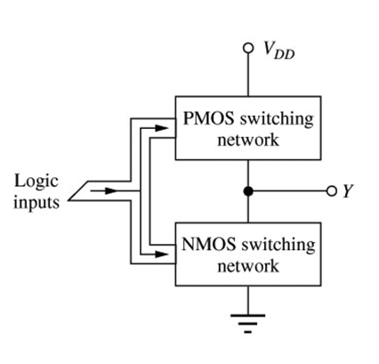
CMOS Logic Design
The design of logic gates for CMOC inverter is different from the similar logic design for NMOS inverters that we considered earlier.
For NMOS gates, the logic involved only the switching transistor.
For CMOS, both transistors are involved, since the input affects both in symmetrical way.
Thus, for each logic input variable in CMOS gate there is one transistor in NMOS network and one transistor in PMOS network.
Load transistor
NMOS logic gate structure
CMOS logic gate structure

Slide 6
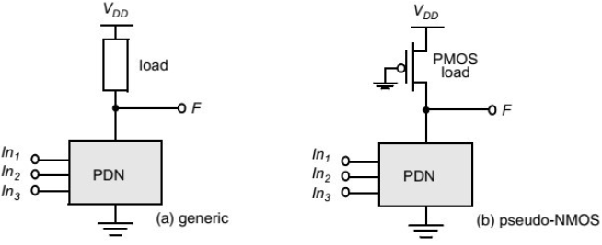
Rationed Logic
Rationed logic is an attempt to reduce the number of transistors required to implement a given logic function, at the cost of reduced robustness and extra power dissipation.
The purpose of the PUN in complementary CMOS is to provide a conditional path between VDD and the output when the PDN is turned off.
In rationed logic, the entire PUN is replaced with a single unconditional load device that pulls up the output for a high output.
Instead of a combination of active pull-down and pull-up networks, such a gate consists of an NMOS pull-down network that realizes the logic function, and a simple load device.

Slide 8
Pass-Transistor Logic
In electronics, Pass Transistor Logic describes several logic families used in the design of integrated circuits.
It reduces the count of transistors used to make different logic gates, by eliminating redundant transistors.
Transistors are used as switches to pass logic levels between nodes of a circuit, instead of as switches connected directly to supply voltage
Switches and switch logic may be formed from simple n- or p-pass transistors or from transmission gates (complementary switches) comprising an n-pass and a p-pass transistor in parallel

Slide 9
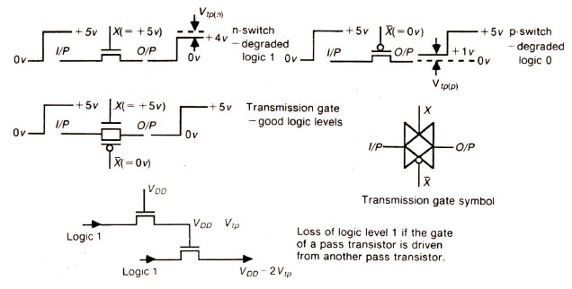
Pass-Transistor Logic

Slide 10
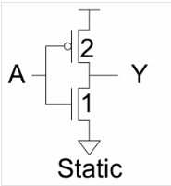
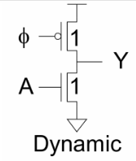
Static logic Vs Dynamic Logic:
Static CMOS circuits use complementary nMOS pulldown and pMOS pullup networks to implement logic gates or logic functions in integrated circuits.
The number of transistors required are 2N. Where N is input.
There is static power loss.
Switching speed is less than Dynamic logic circuit.
Dynamic gates use a clocked pMOS pullup dynamic logic, a clock signal is used to evaluate combinational logic.
The number of transistors required are less (N+2).
The static power loss is very less in a dynamic logic circuit.
Faster switching speed because of lower load capacitance (C_{L}) and C_{int}.

Slide 11
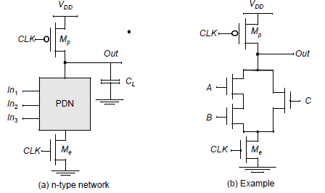
Dynamic CMOS design:
BASIC PRINCIPLES:
Static CMOS is a logic circuit design technique whereby the output is always strongly driven due to it always being connected to either VCC or GND (except when switching). This design is in contrast to Dynamic CMOS which relies on the temporary storage of signal using various load capacitances.
The basic construction of an (n-type) dynamic logic gate is shown in Figure. The PDN is constructed exactly as in complementary CMOS. The operation of this circuit is divided into two major phases: Precharge and Evaluation, with the mode of operation determined by the clock signal CLK.

Slide 12
Dynamic CMOS design:
BASIC PRINCIPLES:
Precharge:
When CLK = 0, the output node Out is precharged to VDD by the PMOS transistor Mp. During that time, the evaluate NMOS transistor Me is off, so that the pull-down path is disabled.
The evaluation FET eliminates any static power that would be consumed during the precharge period.
Evaluation:
For CLK = 1, the precharge transistor Mp is off, and the evaluation transistor Me is turned on. The output is conditionally discharged based on the input values and the pull-down topology.
If the inputs are such that the PDN conducts, then a low resistance path exists between Out and GND and the output is discharged to GND.
During the evaluation phase, the only possible path between the output node and a supply rail is to GND. Consequently, once Out is discharged, it cannot be charged again till then next precharge operation.
The output can be in the high-impedance state during the evaluation period if the pull-down network is turned off.

Slide 13
Dynamic CMOS design:
SPEED AND POWER DISSIPATION OF DYNAMIC LOGIC:
POWER DISSIPATION:
In today's world, we need sleeker devices with more capabilities and longer battery life. This can be achieved by packing more components on smaller chips
Power dissipation occurs in all the circuits that are currently used, which increases the overall power consumption, making it less suitable for mobile applications which need longer battery life.
The power consumption is also considered as an important criterion in VLSI design along with timing and area.
Power dissipation has become one of the major problem as it results in heating up of the device which will affects the operation of a chip.

Slide 14
Dynamic CMOS design:
SPEED AND POWER DISSIPATION OF DYNAMIC LOGIC:
POWER DISSIPATION-
Types of Power Dissipation:
Static power dissipation
Dynamic power dissipation
Total power dissipation is the sum of the dynamic and static power (leakage power).
Dynamic power is the sum of two factors: switching power plus short circuit power.
Dynamic power is dissipated only when switching but static power (leakage power) due to leakage current is continuous.

Slide 15
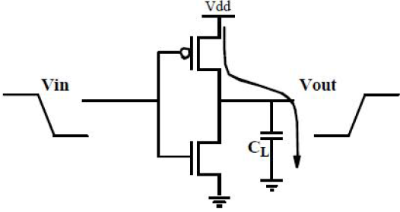
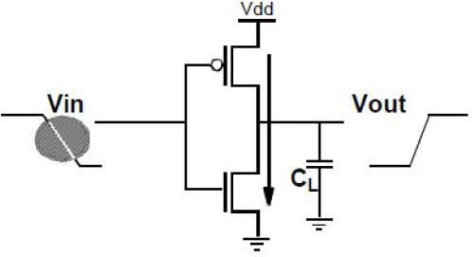
Dynamic CMOS design:
SPEED AND POWER DISSIPATION OF DYNAMIC LOGIC:
The main advantages of dynamic logic are increased speed and reduced implementation area.
POWER DISSIPATION-
Dynamic power dissipation
There are two reasons for dynamic power dissipation. Switching of the device and Short circuit path from supply to ground. This occurs during operation of the device.
Switching of the device Short circuit path from supply to ground.

Slide 16
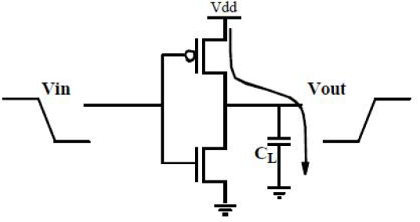
Dynamic CMOS design:
SPEED AND POWER DISSIPATION OF DYNAMIC LOGIC:
POWER DISSIPATION- Dynamic power dissipation
Switching Power dissipation:
Switching power is dissipated when charging or discharging internal and net capacitances.
Each time the capacitor C gets charged through the PMOS transistor, its voltage rises from 0 to V and a certain amount of energy is drawn from the power supply. Part of this energy is dissipated in the PMOS device, while the remainder is stored on the load capacitor.
During the high-to-low transition, this capacitor discharged, and the stored energy is dissipated in the NMOS transistor. This way power is dissipated through charging and discharging.
Where a = switching activity factor, f = switching frequency, C = the effective capacitance and V = the supply voltage.

Slide 17
Dynamic CMOS design:
SPEED AND POWER DISSIPATION OF DYNAMIC LOGIC:
POWER DISSIPATION- Dynamic power dissipation
Short-circuit power dissipation:
It is the power dissipated by an instantaneous short-circuit connection between the supply voltage and the ground at the time the gate switches state.
When the input transition time is very high, there will be certain duration of time “t”, for which both the devices (PMOS and NMOS) are turned ON. Now, there is a short circuit path from V to ground.
Where
Isc= the short circuit current,
V= the supply voltage and t =short circuit time.

Slide 18
Dynamic CMOS design:
ISSUES IN DYNAMIC DESIGN:
There are several important considerations that must be taken into account if one wants dynamic circuits to function properly. This include
Charge leakage,
Charge sharing,
Back gate coupling,
Clock feed through.

Slide 19
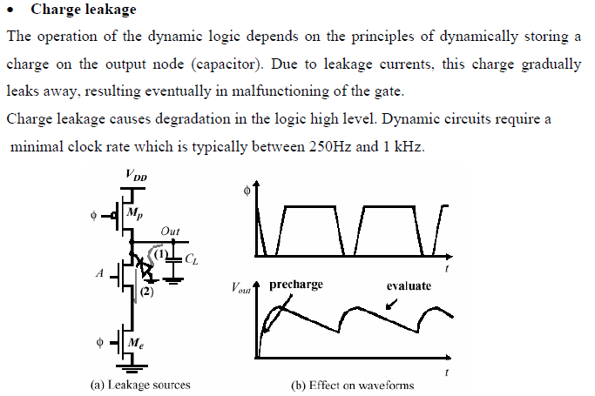
Dynamic CMOS design:
ISSUES IN DYNAMIC DESIGN:

Slide 20
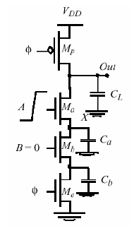
Dynamic CMOS design:
ISSUES IN DYNAMIC DESIGN:
Charge sharing
During the precharge phase, the output node is precharged to V^{DD}. Capacitors Ca and Cb represent the parasitic capacitances of the internal nodes of the circuit.
Assume now that during precharge all inputs are set 0 and the capacitance Ca is discharged.
Assume further that input B remains at 0 during evaluation, while input A makes a 0 to 1 transition. Turning transistor Ma on, the charge stored originally on capacitor C^{L} is redistributed over C^{L} and Ca. This causes a drop in the output voltage, which cannot be recovered due to the dynamic nature of the circuit.

Slide 21
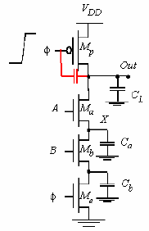
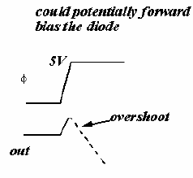
Dynamic CMOS design:
ISSUES IN DYNAMIC DESIGN:
Clock feedthrough:
The clock signal is coupled to the storage node by the gate-source capacitance and the gate-overlap capacitance of the precharge device.
The falling edges of the clock couple into the signal node. The danger of clock feed-through is that it causes the signal level to rise sufficiently above the supply voltage as to forward-bias the junction diode.
This causes electron injection into the substrate and eventually resulting in faulty operation. This can be avoided by providing a sufficient number of well contacts close to the precharge device to collect the injected current.

Slide 22
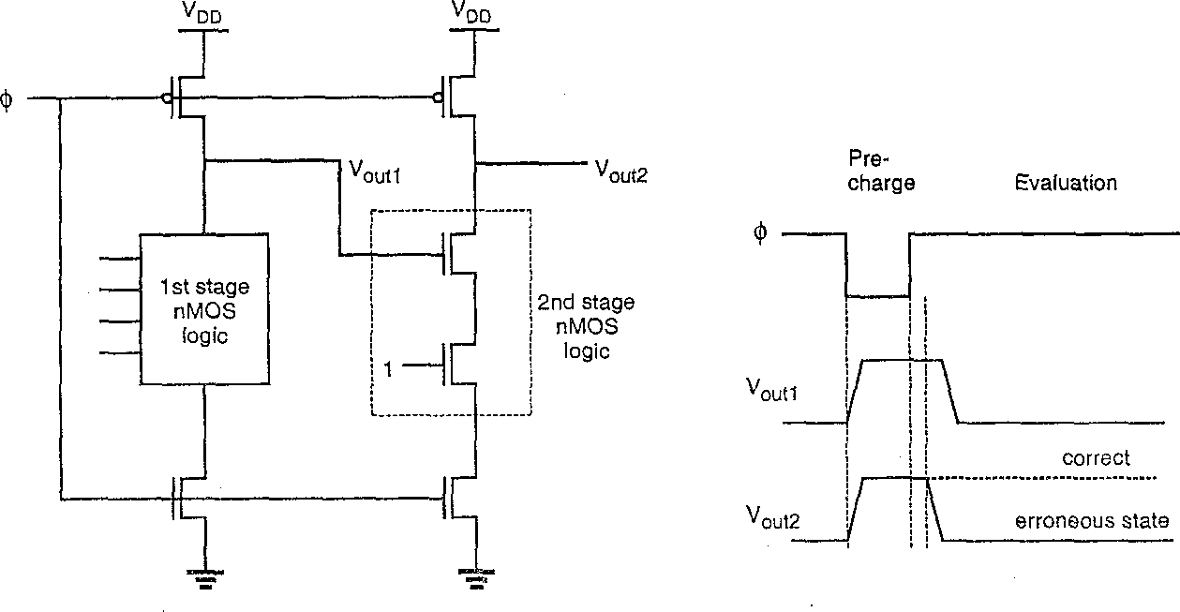
Dynamic CMOS design: Cascading Problem in Dynamic CMOS Logic
If several stages of the previous CMOS dynamic logic circuit are cascaded together using the same clock φ, a problem in evaluation involving a built-in “race condition” will exist
Consider the two stage dynamic logic circuit below:
During pre-charge, both Vout1 and Vout2 are pre-charged to Vdd
When φ goes high to begin evaluate, all inputs at stage 1 require some finite time to resolve, but during this time charge may erroneously be discharged from Vout2
e.g. assume that eventually the 1st stage NMOS logic tree conducts and fully discharges Vout1, but since all the inputs to the N-tree all not immediately resolved, it takes some time for the N-tree to finally discharge Vout1 to GND.
If, during this time delay, the 2nd stage has the input condition shown with bottom NMOS transistor gate at a logic 1, then Vout2 will start to fall and discharge its load capacitance until Vout1 finally evaluates and turns off the top series NMOS transistor in stage 2
The result is an error in the output of the 2nd stage Vout2

Slide 23
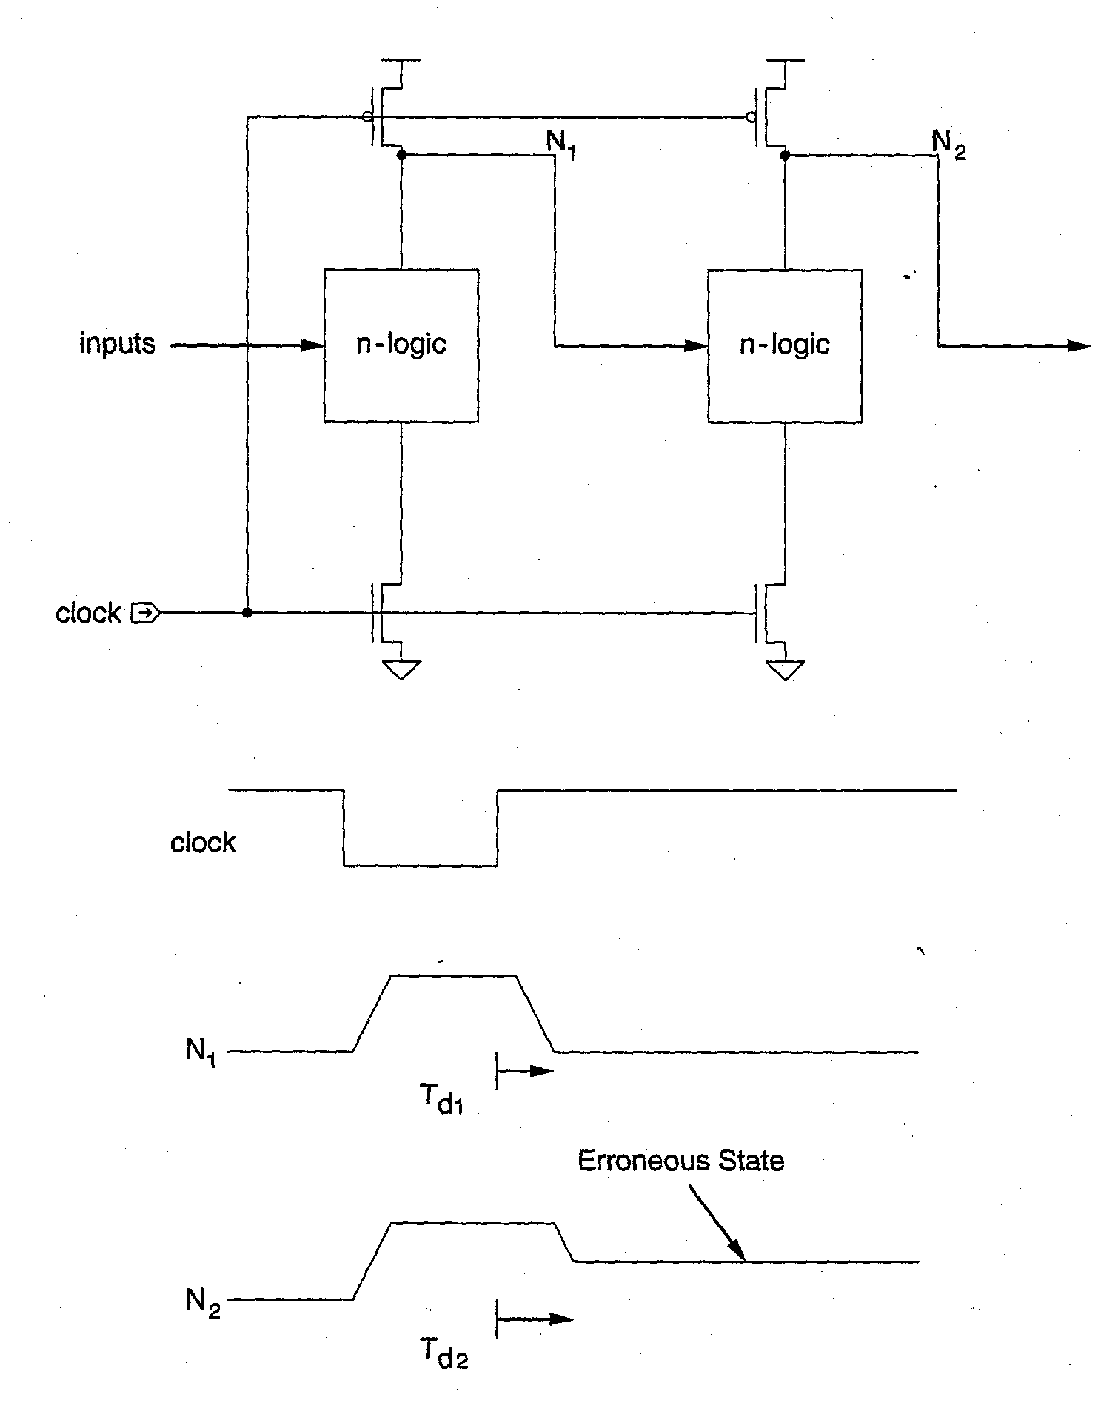
Cascaded Dynamic CMOS Logic Gates: Evaluate Problem
With simple cascading of dynamic CMOS logic stages, a problem arises in the evaluate cycle:
The pre-charged high voltage on Node N2 in stage 2 may be inadvertently (partially) discharged by logic inputs to stage 2 which have not yet reached final correct (low) values from the stage 1 evaluation operation.
Can not simply cascade dynamic CMOS logic gates without preventing unwanted bleeding of charge from pre-charged nodes
Possible Solutions:
two phase clocks
use of inverters to create Domino Logic
NP Domino Logic
Zipper/NORA logic

Slide 24
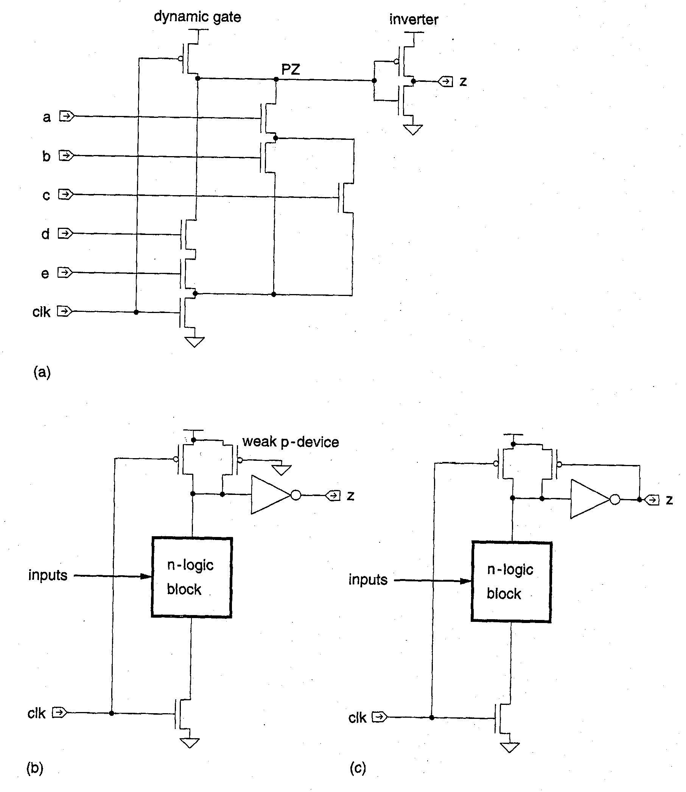
CMOS Domino Logic
The problem with faulty discharge of precharged nodes in CMOS dynamic logic circuits can be solved by placing an inverter in series with the output of each gate
All inputs to N logic blocks (which are derived from inverted outputs of previous stages) therefore will be at zero volts during precharge and will remain at zero until the evaluation stage has logic inputs to discharge the precharged node PZ.
This circuit approach avoids the race problem of “vanilla” cascaded dynamic CMOS
However, all circuits only provide non- inverted outputs
In (b) a weak P device compensates for charge loss due to charge sharing and leakage at low frequency clock operation
In (c ) the weak P device can be used to latch the output high

Slide 25
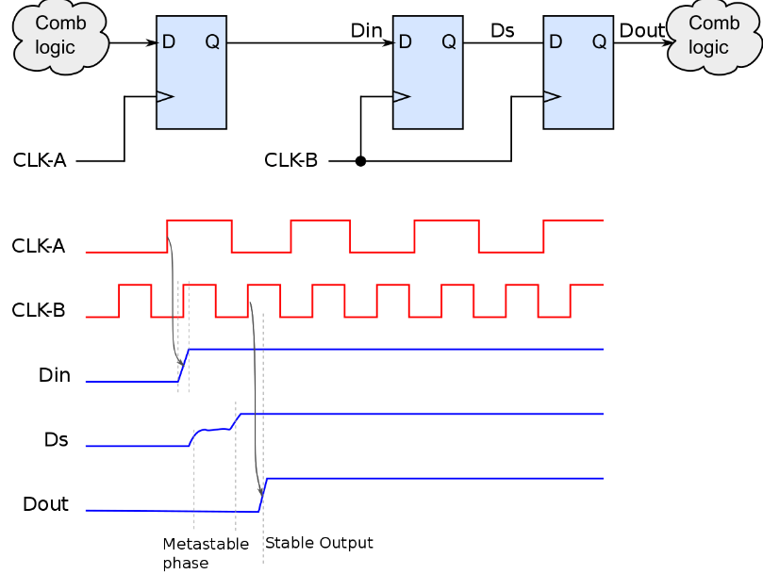
Meta Stability:
In digital circuit, the signal is required to be within certain voltage or current limits (logic 0/1 levels) for correct circuit operation.
If the signal is within an intermediate range other than acceptable 0/1 levels, the logic gates’ behaviour will be faulty.
The circuit is in metastable state when it is unable to settle into a stable “0” or “1” within an acceptable time for proper circuit operation. This may lead to system failures.

Slide 26
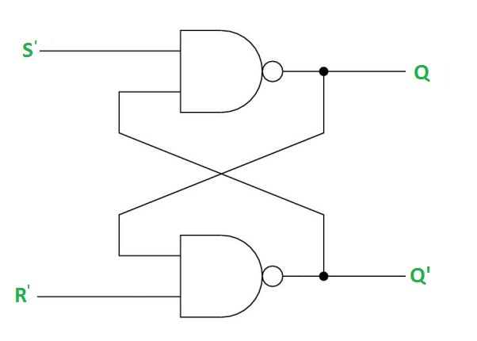
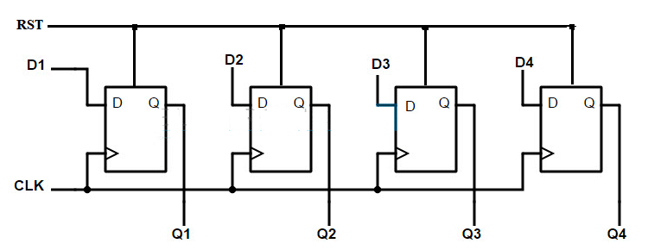
LATCH:
A latch is an electronic logic circuit that has two inputs and one output. One of the inputs is called the SET input; the other is called the RESET input. Latch circuits can be either active-high or active-low.
REGISTER:
A Register is a collection of flip flops. A flip flop is used to store single bit digital data. For storing a large number of bits, the storage capacity is increased by grouping more than one flip flops. If we want to store an n-bit word, we have to use an n-bit register containing n number of flip flops.

Slide 27
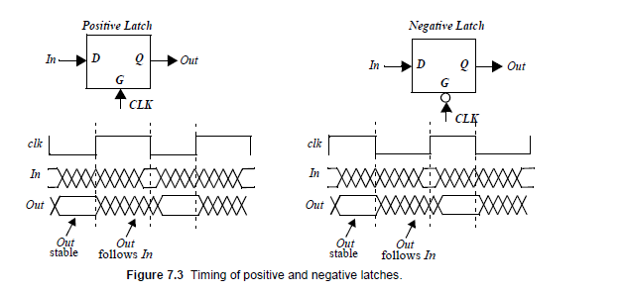

Slide 28
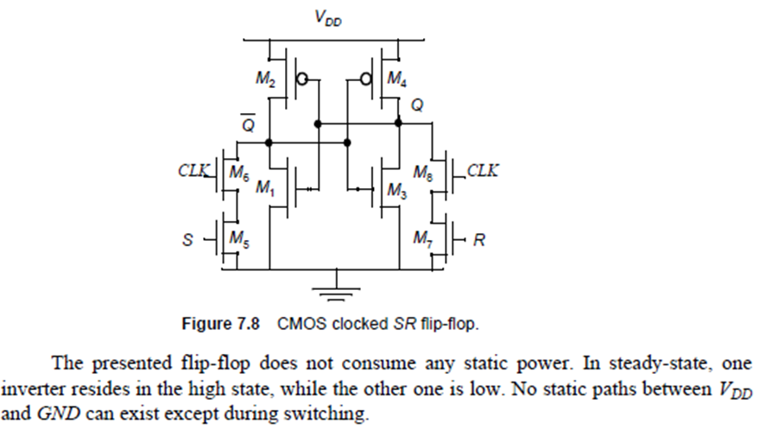
LATCH based design:

Slide 29
Multiplexer-Based Latches:
There are many approaches for constructing latches. One very common technique involves the use of transmission gate multiplexers.
Multiplexer based latches can provide similar functionality to the SR latch, but has the important added advantage that the sizing of devices only affects performance and is not critical to the functionality

Slide 30
Multiplexer-Based Latches:

