Slide 1
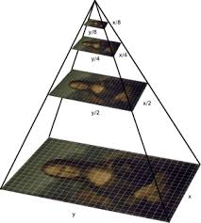
IMAGE PYRAMIDS
In digital image processing, an image pyramid is a multi-scale representation of an image, where the image is progressively downsampled to create different levels of resolution.
This structure is useful for applications like image compression, object detection, and feature extraction.

Slide 2
IMAGE PYRAMIDS
Image Pyramid = Hierarchical representation of an image
Low Resolution
No details in image
(blurred image)
Low frequencies
Details in image
Low+high frequencies
High Resolution
A collection of images at different resolutions.

Slide 3
Outlines :-
Gaussian Pyramid
Laplacian Pyramid
Applications

Slide 4
Gaussian Pyramid:
Created by blurring and downsampling an image at each level.
Used for image analysis,
Feature extraction, and
Multi-scale image processing.
How is an image pyramid created?
The original image is repeatedly smoothed and subsampled
Each image is a filtered and subsampled copy of the previous image
The resulting images are called "levels" of the pyramid

Slide 5
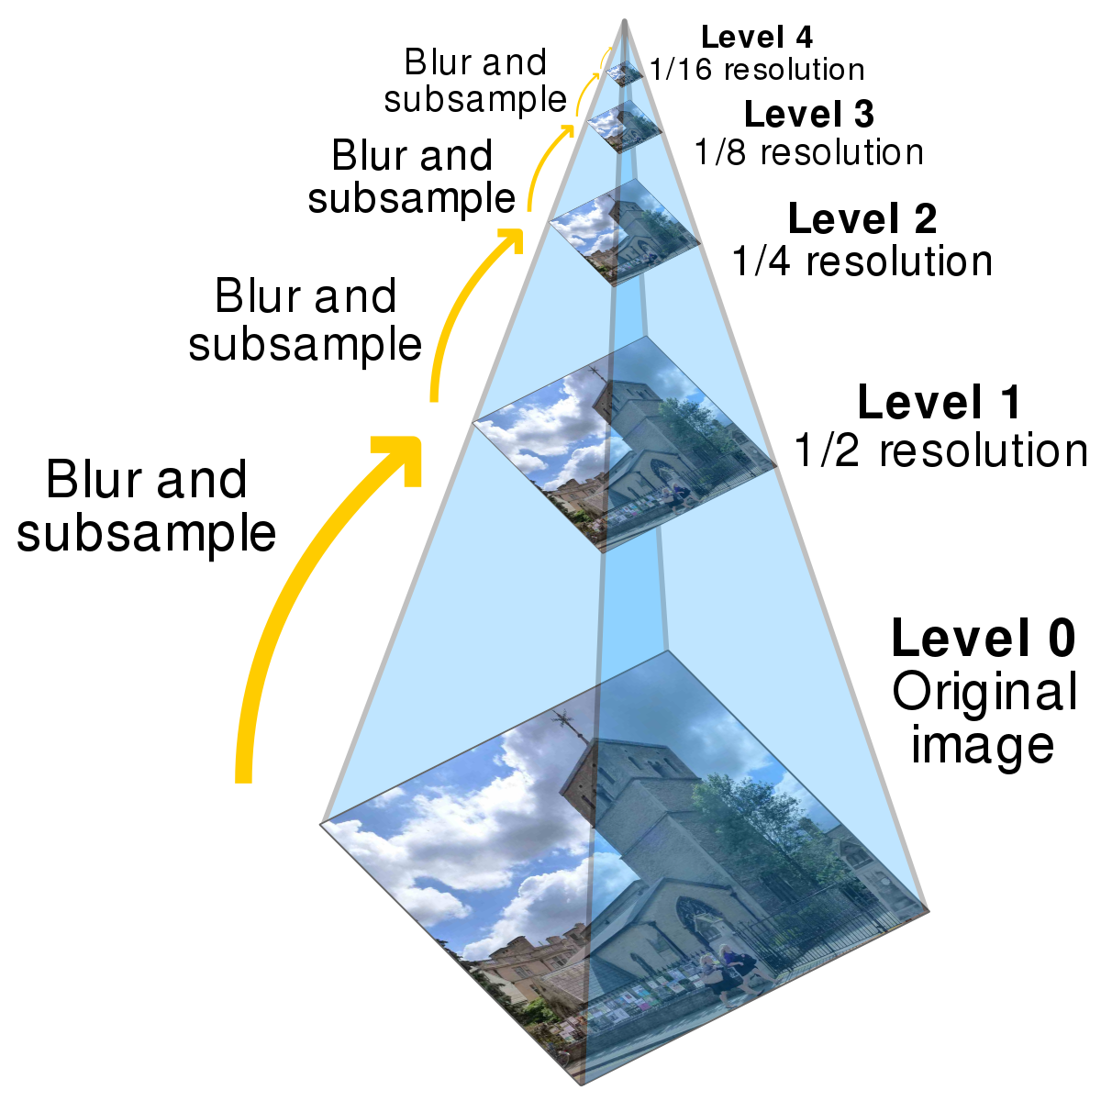
GAUSSIAN PYRAMID
The Gaussian Pyramid: It is representation of images in multiple scales

Slide 6
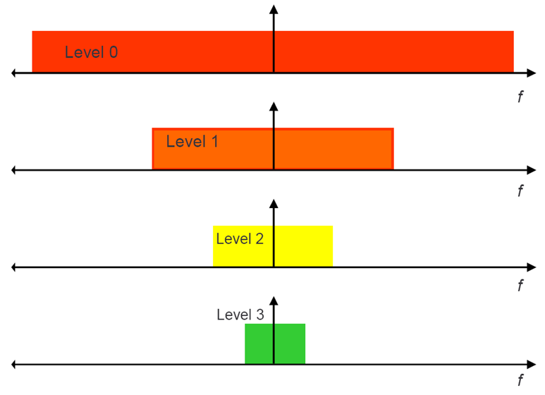
Gaussian Pyramid Frequency Composition

Slide 7
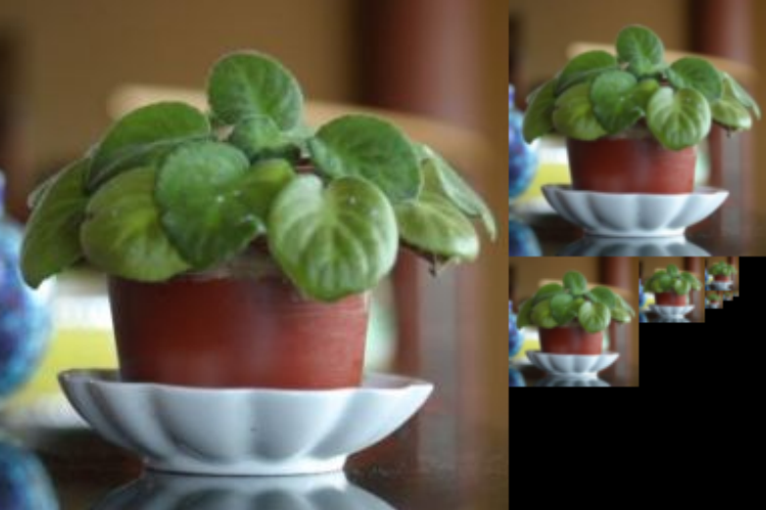
GAUSSIAN PYRAMID
The goal is to define a representation in which image information at different
scales is explicitly available (i.e. does not need to be computed when needed)
Applications:
Scale invariant template matching (like faces)
Progressive image transmission
Image blending
Efficient feature search

Slide 8
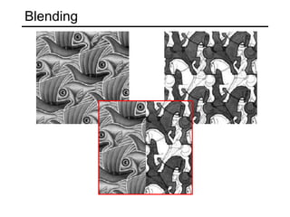

Slide 9
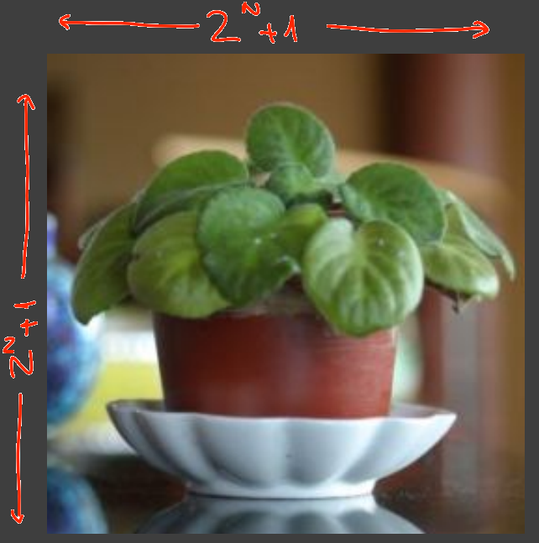
GAUSSIAN PYRAMID
The elements of a Gaussian Pyramids are smoothed copies of the image at different scales.
Input: Image I of size (2^{N+1})x(2^{N+i})

Slide 10
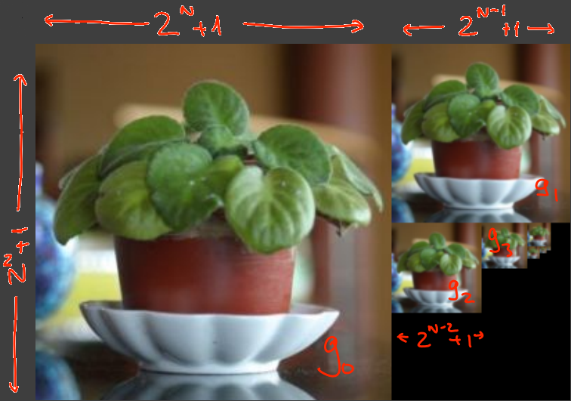
GAUSSIAN PYRAMID
Output: Images g0, g1,…, gN-1
where the size of g_{i} is: (2^{N-i}+1)x(2^{N-i}+1)

Slide 11
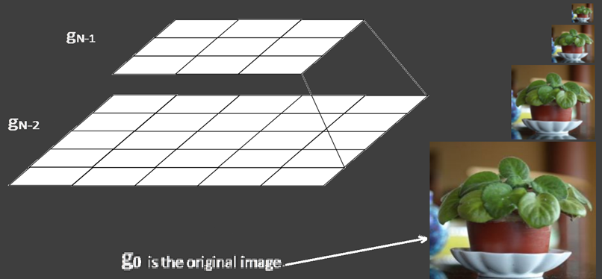
Working:
The "pyramid" is constructed by repeatedly calculating a weighted average of the neighboring pixels of a source image and scaling the image down. It can be visualized by stacking progressively smaller versions of the image on top of one another. This process creates a pyramid shape with the base as the original image and the tip a single pixel representing the average value of the entire image.

Slide 12
Gaussian – Image filter

Slide 13
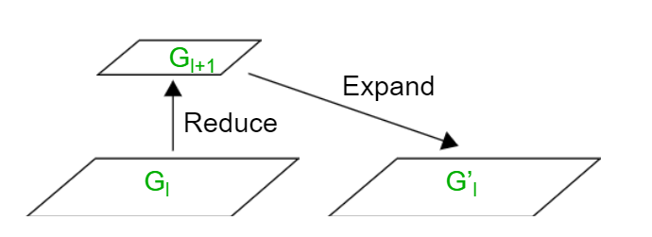
LAPLACIAN PYRAMID
Laplacian have decomposition based on difference-of-lowpass filters.
The image is recursively decomposed into low-pass and highpass bands.
G₀, G₁, .... = the levels of a Gaussian Pyramid.
Predict level G_{l} from level G_{l +1} by expanding G_{l +1} to G’_{l}
Denote by L_{l} the error in prediction: L_{l} = G_{l} – G’_{l}
L₀ , L₁, .... = the levels of a Laplacian Pyramid.

Slide 14
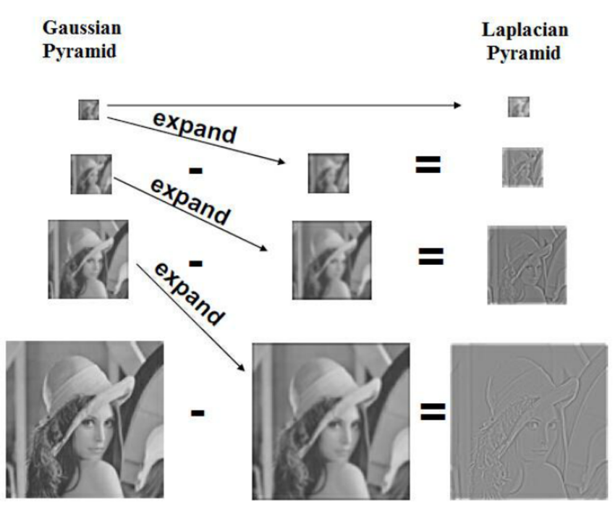
LAPLACIAN PYRAMID
Laplacian of Gaussian can be approximated by the difference between two different Gaussians

Slide 15
LAPLACIAN PYRAMID
We create the Laplacian pyramid from the Gaussian pyramid using the formula below :
g0, g1,…. are the levels of a Gaussian pyramid
L0, L1,…. are the levels of a Laplacian pyramid

Slide 16
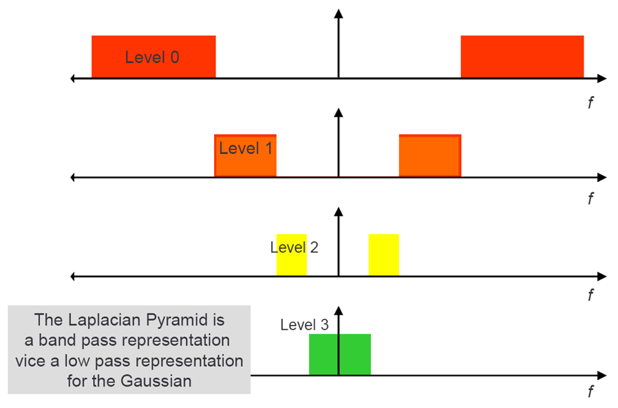
LAPLACIAN PYRAMID Frequency Composition

Slide 17
LAPLACIAN -- Image filter

Slide 18
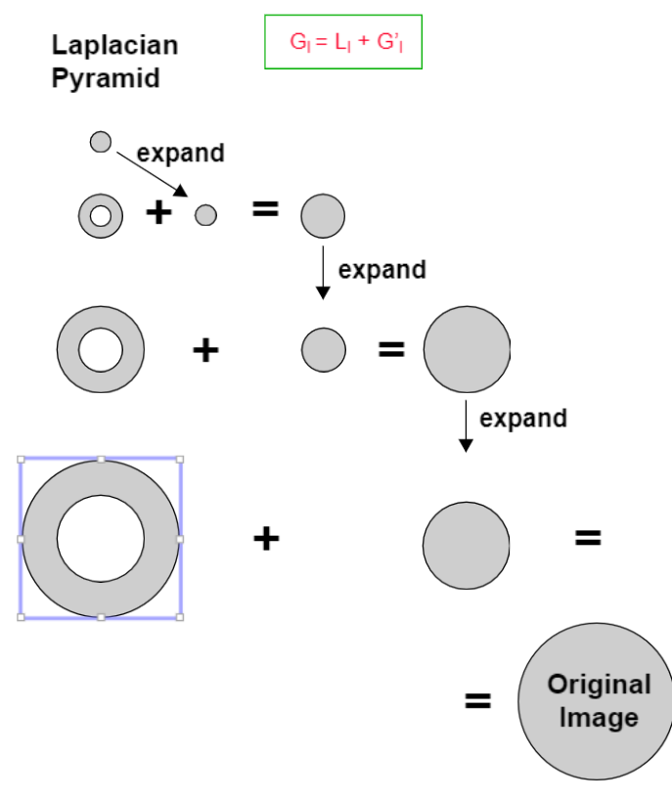
Reconstruction of the original image from the Laplacian Pyramid

Slide 19
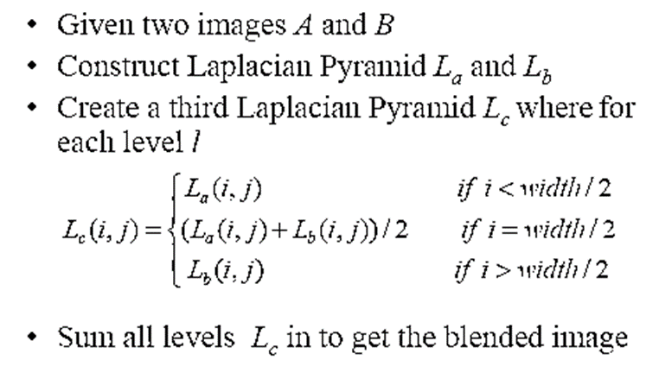
APPLICATIONS
Image Blending and Mosaicing

Slide 20
Blending Apples and Oranges

Slide 21
Pyramid blending of Regions

Slide 22
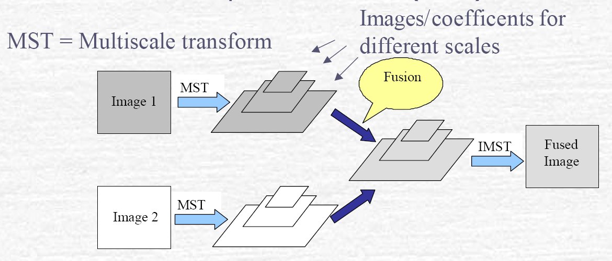
Image Fusion
Multi-scale Transform (MST) = Obtain Pyramid from Image
Inverse Multi-scale Transform (IMST) = Obtain Image from Pyramid

Slide 23
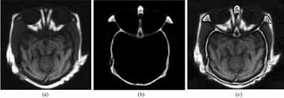
Thank You

